Slide 1


What is an Ontology and What is it Useful for?
Dr. Barry Smith
Director
National Center for Ontological Research

Slide 2
Barry Smith – who am I?
Director: National Center for Ontological Research (Buffalo)
Founder: Ontology for the Intelligence Community (OIC, now STIDS) conference series
Ontology work for:
NextGen (Next Generation) Air Transportation System
National Nuclear Security Administration, DoE
Joint-Forces Command Joint Warfighting Center
Army Net-Centric Data Strategy Center of Excellence
and for many national and international science and healthcare agencies

Slide 3
The problem: many, many silos
DoD spends more than $6B annually developing a portfolio of more than 2,000 business systems and Web services
these systems are poorly integrated
deliver redundant capabilities,
make data hard to access, foster error and waste
prevent secondary uses of data
https://ditpr.dod.mil/ Based on FY11 Defense Information Technology Repository (DITPR) data

Slide 4
Some questions
How to find data?
How to understand data when you find it?
How to use data when you find it?
How to compare and integrate with other data?
How to avoid data silos?
How to make a battlefield situation rapidly understandable
How to decide what to do next in a battlefield situation
Notes:
http://www.w3.org/People/Ivan/CorePresentations/HighLevelIntro/

Slide 5
The problem of retrieval, integration and analysis of siloed data
is not confined to the DoD
affects every domain due to massive legacy of non-interoperable data models and data systems
and as new systems are created along the same lines, the situation is constantly getting worse.

Slide 6
One solution: Über-model
must be built en bloc beforehand
inflexible, unresponsive to warfighter needs
heavy-duty manual effort for both construction and ingestion, with loss and/or distortion of source data and data-semantics
might help with data retrieval and integration
but offers limited analytic capability
has a limited lifespan because it rests on one point of view

Slide 7
A better solution, begins with the Web (net-centricity)
You build a site
Others discover the site and they link to it
The more they link, the more well known the page becomes (Google …)
Your data becomes discoverable
Notes:
http://www.w3.org/People/Ivan/CorePresentations/HighLevelIntro/

Slide 8
The roots of Semantic Technology
Each group creates a controlled vocabulary of the terms commonly used in its domain, and creates an ontology out of these terms using OWL syntax
Binds this ontology to its data and makes these data available on the Web
The ontologies are linked e.g. through their use of some common terms
These links create links among all the datasets, thereby creating a ‘web of data’
Notes:
http://www.w3.org/People/Ivan/CorePresentations/HighLevelIntro/

Slide 9
Where we stand today
increasing availability of semantically enhanced data and semantic software
increasing use of OWL in attempts to create useful integration of on-line data and information
“Linked Open Data” the New Big Thing

Slide 10
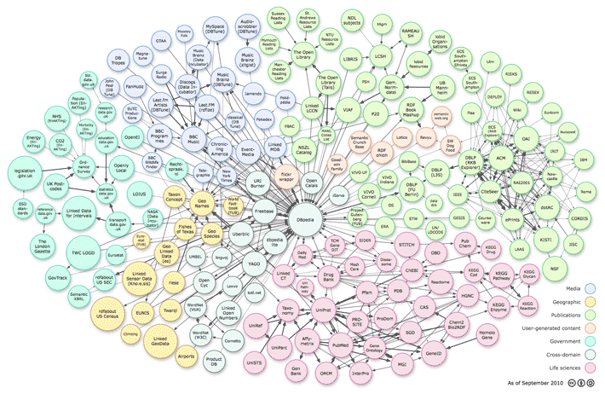
as of September 2010

Slide 11
The problem: the more Semantic Technology is successful, they more it fails
The original idea was to break down silos via common controlled vocabularies for the tagging of data
The very success of the approach leads to the creation of ever new controlled vocabularies – semantic silos – as ever more ontologies are created in ad hoc ways
Every organization and sub-organization now wants to have its own “ontology”
The Semantic Web framework as currently conceived and governed by the W3C yields minimal standardization

Slide 12
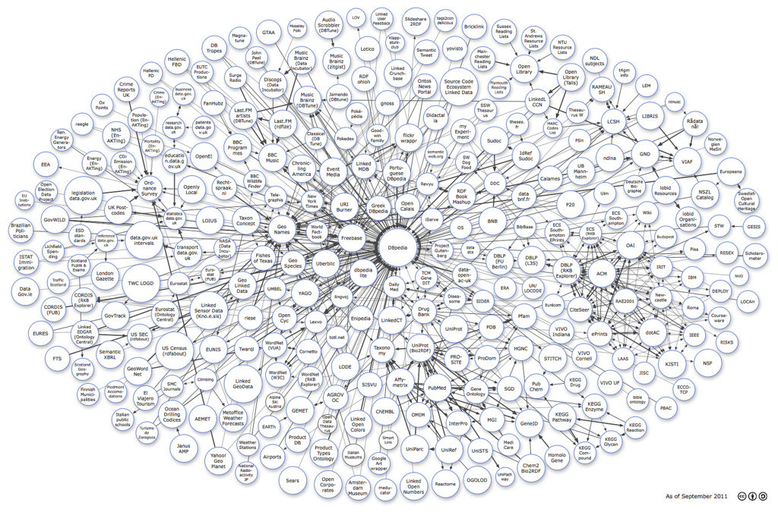
Divided we fail

Slide 13
United we also fail

Slide 14
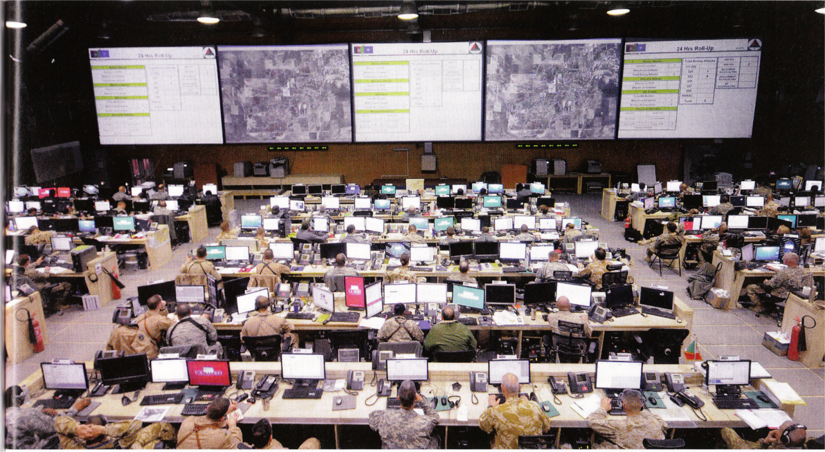
The problem of joint / coalition operations
Intelligence
Fire Support
Targeting
Maneuver &
Blue Force Tracking
Air Operations
Civil-Military Operations
Logistics

Slide 15
An alternative solution: Semantic Enhancement
A distributed incremental strategy of coordinated annotation
data remain in their original state (is treated at ‘arms length’)
‘tagged’ using interoperable ontologies created in tandem
allows flexible response to new needs, adjustable in real time
can be as complete as needed, lossless, long-lasting because flexible and responsive
big bang for buck – measurable benefit even from first small investments
strong tool support for data analysis
multiple successful precedents
The strategy works only to the degree that it rests on shared governance and training

Slide 16
Dennis E. Wisnosky: A Vision for DoD Solution Architectures

Slide 17
What can semantic technology do for you?
software, hardware, business processes, target domains of interest change rapidly
but meanings of common words change only slowly
semantic technology allows these meanings to be encoded separately from data files and from application code – decoupling of semantics from data and applications
ontologies (controlled, logically structured, vocabularies), which are used to enhance legacy and source content
to make these contents retrievable even by those not involved in their creation
to support integration of data deriving from heterogeneous sources
to allow unanticipated secondary uses
Notes:
http://www.w3.org/People/Ivan/CorePresentations/HighLevelIntro/

Slide 18
The capability for massing timely and accurate artillery fires by dispersed batteries upon single targets required
real-time communications of a sort that could
create a common operational picture that could take account of new developments in the field
thereby transforming dispersed batteries into a single system of interoperable modules.
this was achieved (in Ft. Sill around 1939) through
a new type of information support
a new type of governance and training
new artillery doctrine

Slide 19
The capability for massing timely and accurate intelligence “fires”
will similarly require real-time pooling of information of a sort that can
create a common operational picture able to be constantly updated in light of new developments in the field
thereby transforming dispersed data artifacts within the Cloud into a single system of interoperable modules
This will require in turn
a new type of support (for semantic enhancement of data)
a new type of governance and training
new intelligence doctrine to include applied semantics

Slide 20
ICODES
Integrated Computerized Deployment System
a decision-support system for rapid development of conveyance plans. Used by unit personnel to react rapidly and efficiently to changing transportation requirements
http://digitalcommons.calpoly.edu/cadrc/

Slide 21
ICODES
from 2 days to 10 minutes manual coding effort
more elaborate loading scenarios can be supported
different forces can share the same ships because their loading categories are built into the same ontology
high flexibility as cargoes, ships and loading technologies change
Performance Metrics
Tested Procedure V 3.0 (1998) V 5.0( 2001) V 5.4 (2005)
Create 2-ship load-plan, 2,400 normal cargo items 20 min 8 min 1.5 min
Create 2-ship load-plan, 1,200 hazardous cargo items 25 min 11 min 2.5 min
Unload inventory of 2,400 items from 2 ships 10 min 5 min 1.0 min

Slide 22
Towards ontology coordination
Barry Smith

Slide 23
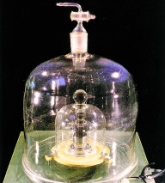
On June 22, 1799, in Paris, everything changed

Slide 24
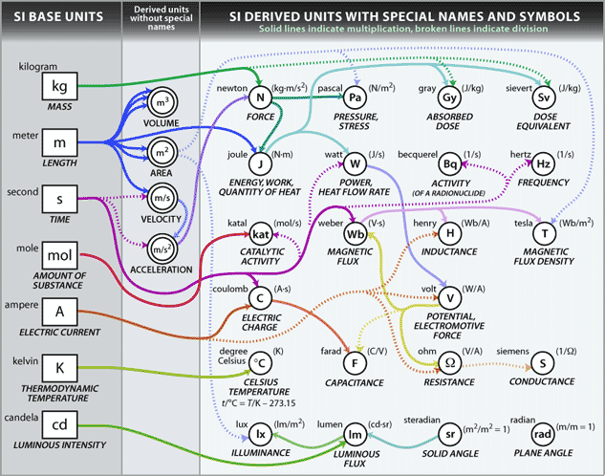
International System of Units

Slide 25
How to find data?
How to find other people’s data?
How to find your own data?
How to reason with data when you find it?
How to combine data from multiple sources?

Slide 26
How to solve the problem of making the data we find queryable and re-usable by others?
Part of the solution must involve: standardized terminologies and coding schemes, analogous to the SI System of Units

Slide 27
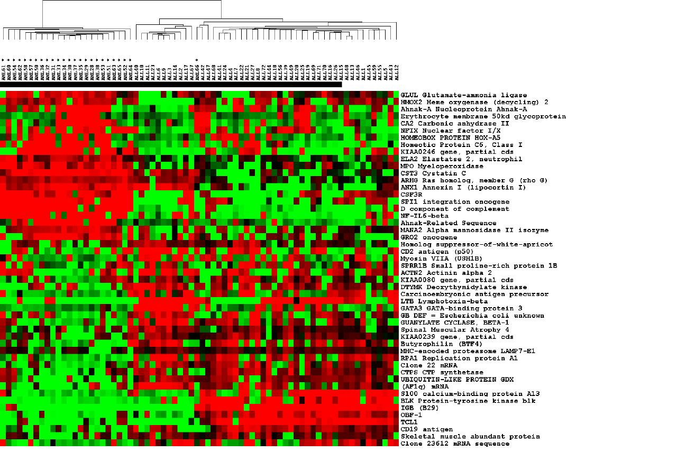
ontologies = standardized labels
designed for use in annotations
to make the data cognitively
accessible to human beings
and algorithmically accessible
to computers
Notes:
dir.niehs.nih.gov/ microarray/datamining/

Slide 28
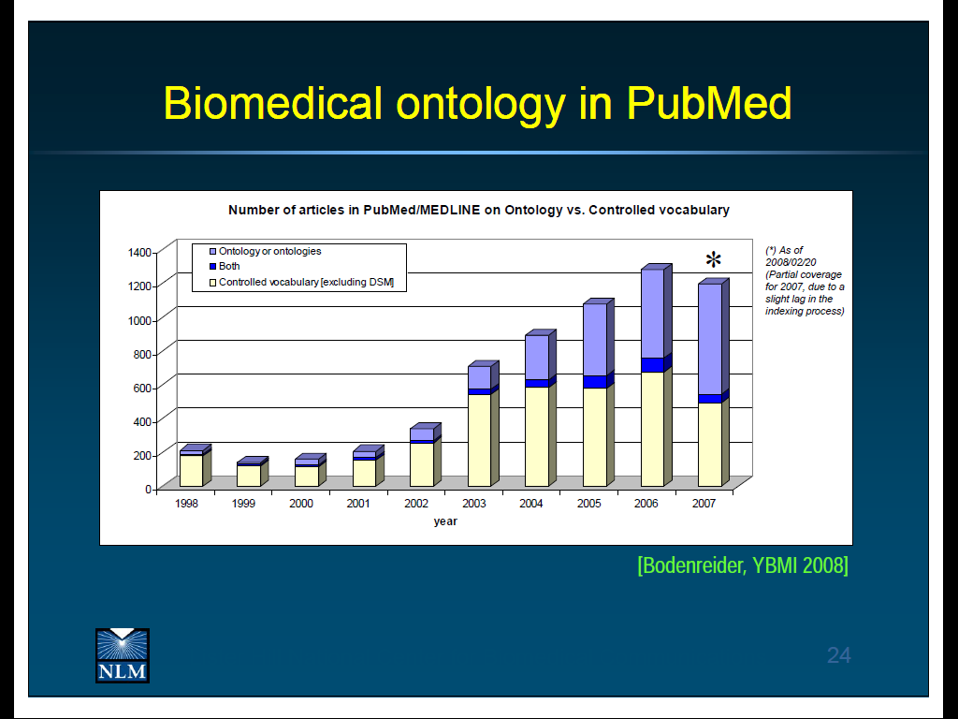
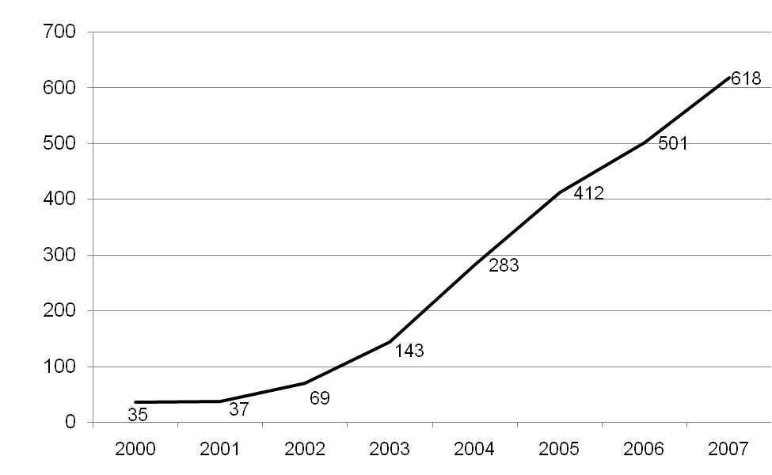
Uses of ‘ontology’ in PubMed abstracts

Slide 29
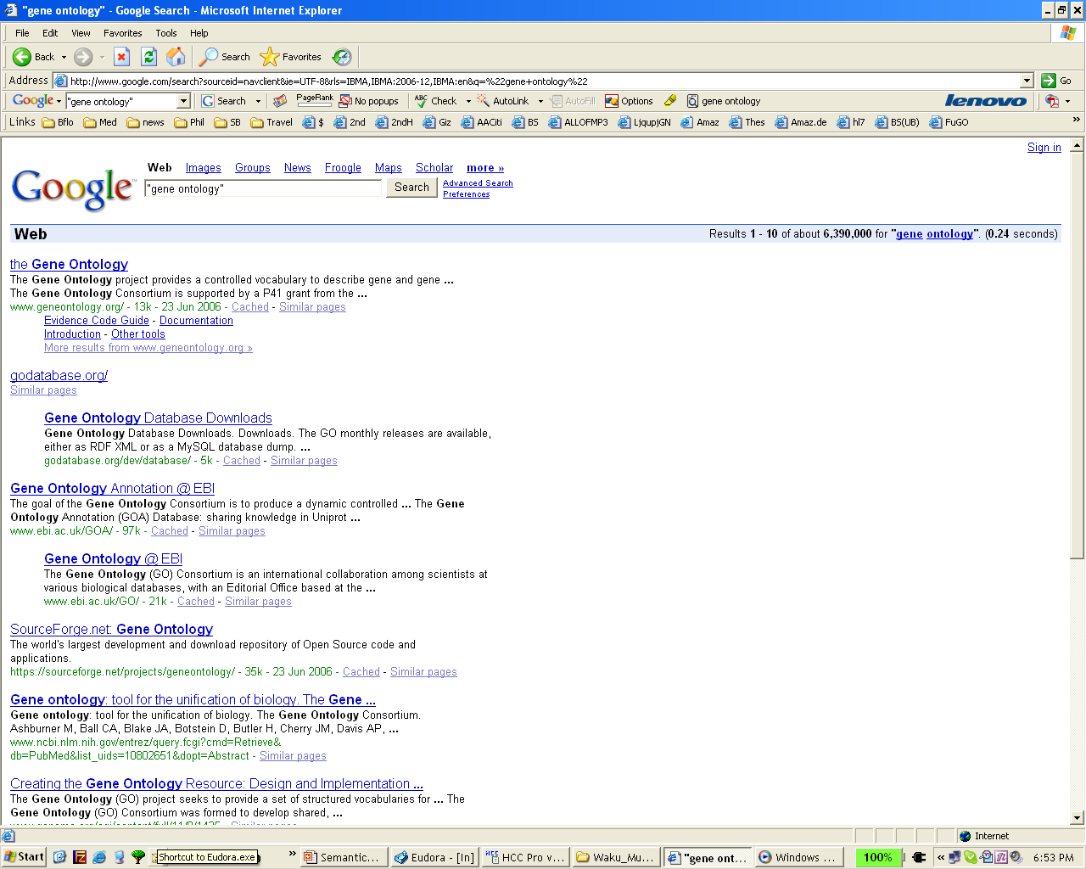
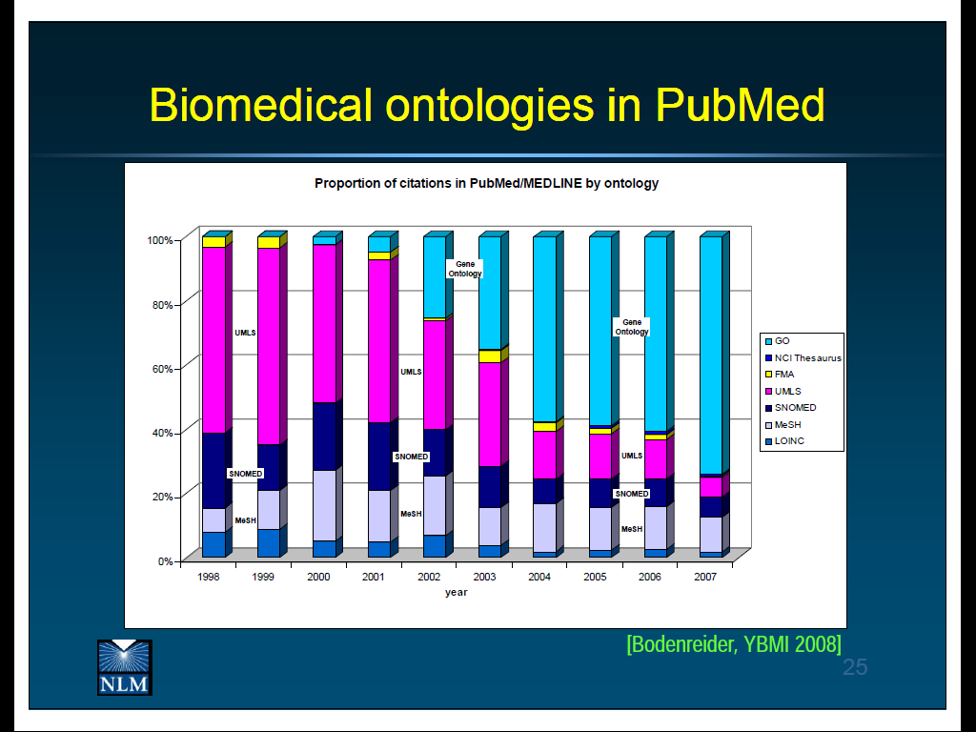

Slide 30
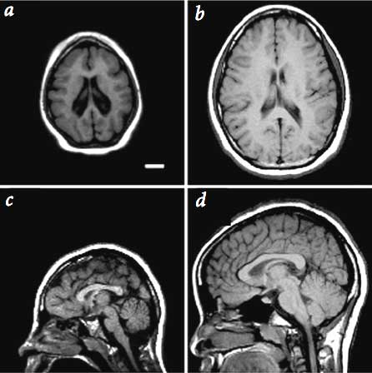
ontologies = high quality controlled
structured vocabularies for the
annotation (description, tagging) of
data, images, emails, documents, …
Notes:
http://pharyngula.org/images/aspm-mri.jpg

Slide 31
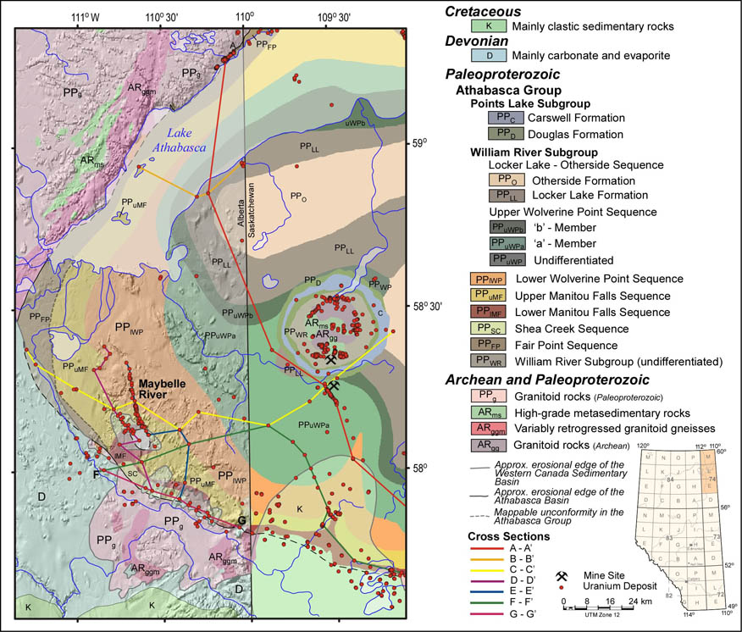
compare: legends for maps
compare: legends for maps
Notes:
http://www.ags.gov.ab.ca/GRAPHICS/uranium/athabasca_group_map_with_legend.jpg

Slide 32
compare: legends for maps
common legends allow (cross-border) integration
Notes:
http://www.ags.gov.ab.ca/GRAPHICS/uranium/athabasca_group_map_with_legend.jpg

Slide 33
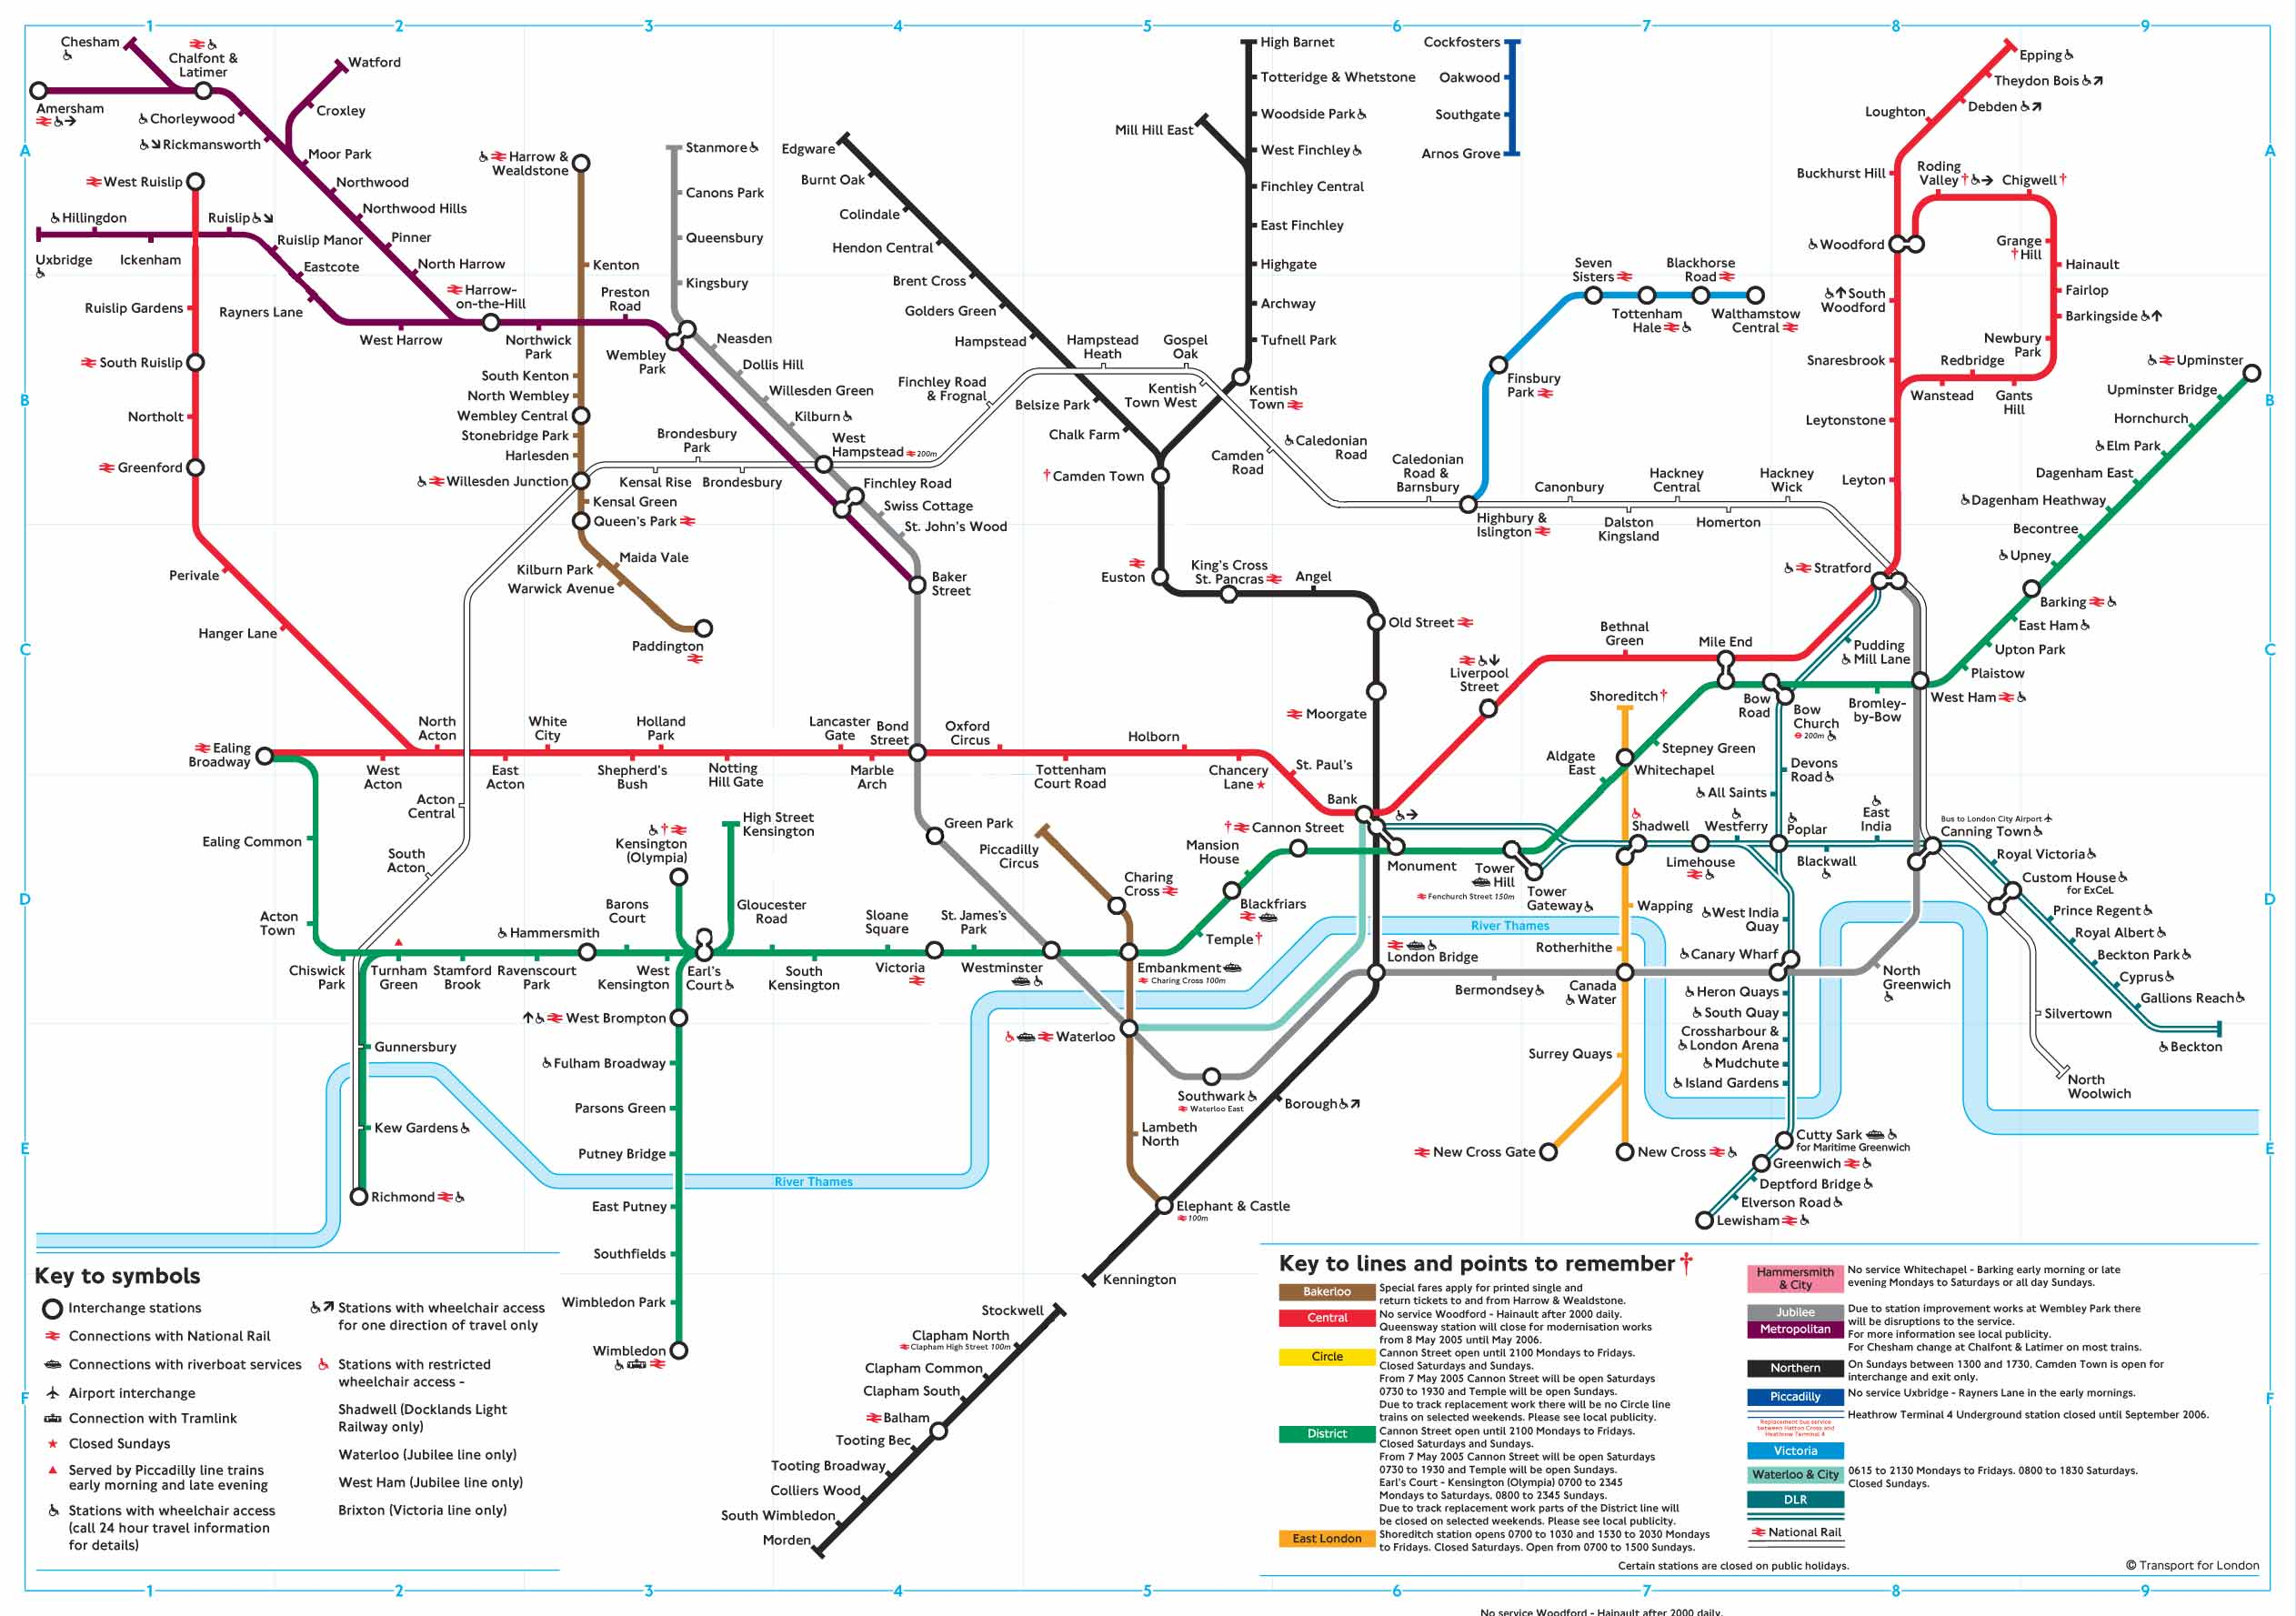


Slide 34
types vs. instances

Slide 35
names of instances

Slide 36
names of types

Slide 37
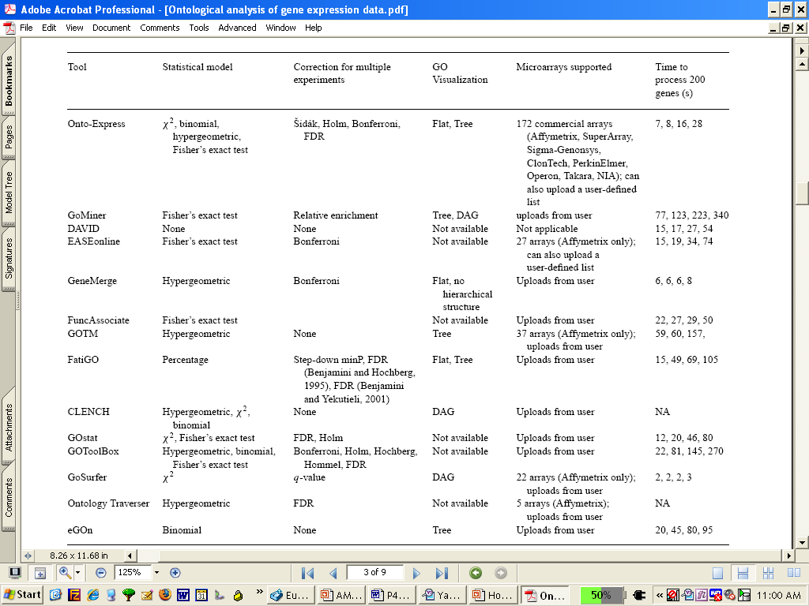
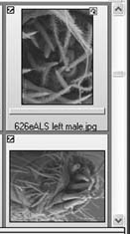
The Gene Ontology
MouseEcotope
GlyProt
sphingolipid
transporter
activity
DiabetInGene
GluChem

Slide 38
The Gene Ontology
MouseEcotope
GlyProt
Holliday junction
helicase complex
DiabetInGene
GluChem

Slide 39
The Gene Ontology
MouseEcotope
GlyProt
sphingolipid
transporter
activity
DiabetInGene
GluChem

Slide 40
Common legends
help human beings use and understand complex representations of reality
help human beings create useful complex representations of reality
help computers process complex representations of reality
help glue data together
But common legends serve these purposes only if the ontologies themselves are developed in a coordinated, non-redundant fashion

Slide 41
A good solution to this silo problem must be:
modular
incremental
independent of hardware and software
bottom-up
evidence-based
revisable
incorporate a strategy for motivating potential developers and users

Slide 42
RELATION TO TIME GRANULARITY | CONTINUANT |  |  |  | OCCURRENT
 | INDEPENDENT |  | DEPENDENT
ORGAN AND ORGANISM | Organism (NCBI Taxonomy) | Anatomical Entity (FMA, CARO) | Organ Function (FMP, CPRO) | Phenotypic Quality (PaTO) | Biological Process (GO)
CELL AND CELLULAR COMPONENT | Cell (CL) | Cellular Component (FMA, GO) | Cellular Function (GO)
MOLECULE | Molecule (ChEBI, SO, RnaO, PrO) |  | Molecular Function (GO) |  | Molecular Process (GO)
The Open Biomedical Ontologies (OBO) Foundry

Slide 43
 | CONTINUANT |  |  |  | OCCURRENT
 | INDEPENDENT |  | DEPENDENT
ORGAN AND ORGANISM | Organism (NCBI Taxonomy) | Anatomical Entity (FMA, CARO) | Organ Function (FMP, CPRO) | Phenotypic Quality (PaTO) | Organism-Level Process (GO)
CELL AND CELLULAR COMPONENT | Cell (CL) | Cellular Component (FMA, GO) | Cellular Function (GO) |  | Cellular Process (GO)
MOLECULE | Molecule (ChEBI, SO, RNAO, PRO) |  | Molecular Function (GO) |  | Molecular Process (GO)
RELATION TO TIME
GRANULARITY
rationale of OBO Foundry coverage

Slide 44
RELATION TO TIME GRANULARITY | CONTINUANT |  |  |  | OCCURRENT
 | INDEPENDENT |  | DEPENDENT
COMPLEX OF ORGANISMS | Family, Community, Deme, Population |  | Organ Function (FMP, CPRO) | Population Phenotype | Population Process
ORGAN AND ORGANISM | Organism (NCBI Taxonomy) | Anatomical Entity (FMA, CARO) |  | Phenotypic Quality (PaTO) | Biological Process (GO)
CELL AND CELLULAR COMPONENT | Cell (CL) | Cellular Component (FMA, GO) | Cellular Function (GO)
MOLECULE | Molecule (ChEBI, SO, RnaO, PrO) |  | Molecular Function (GO) |  | Molecular Process (GO)
Population-level ontologies

Slide 45
RELATION TO TIME GRANULARITY | CONTINUANT |  |  |  |  | OCCURRENT
 | INDEPENDENT |  |  | DEPENDENT
ORGAN AND ORGANISM | Organism (NCBI Taxonomy) | Anatomical Entity (FMA, CARO) |  | Organ Function (FMP, CPRO) | Phenotypic Quality (PaTO) | Biological Process (GO)
CELL AND CELLULAR COMPONENT | Cell (CL) | Cellular Component (FMA, GO) |  | Cellular Function (GO)
MOLECULE | Molecule (ChEBI, SO, RnaO, PrO) |  |  | Molecular Function (GO) |  | Molecular Process (GO)
environments
Environment Ontology

Slide 46
Creation of new ontology consortia, modeled on the OBO Foundry
NIF Standard | Neuroscience Information Framework
eagle-I Ontologies | used by VIVO and CTSA connect for publications, patents, credentials, data and sample collections
IDO Consortium | Infectious Disease Ontology

Slide 47
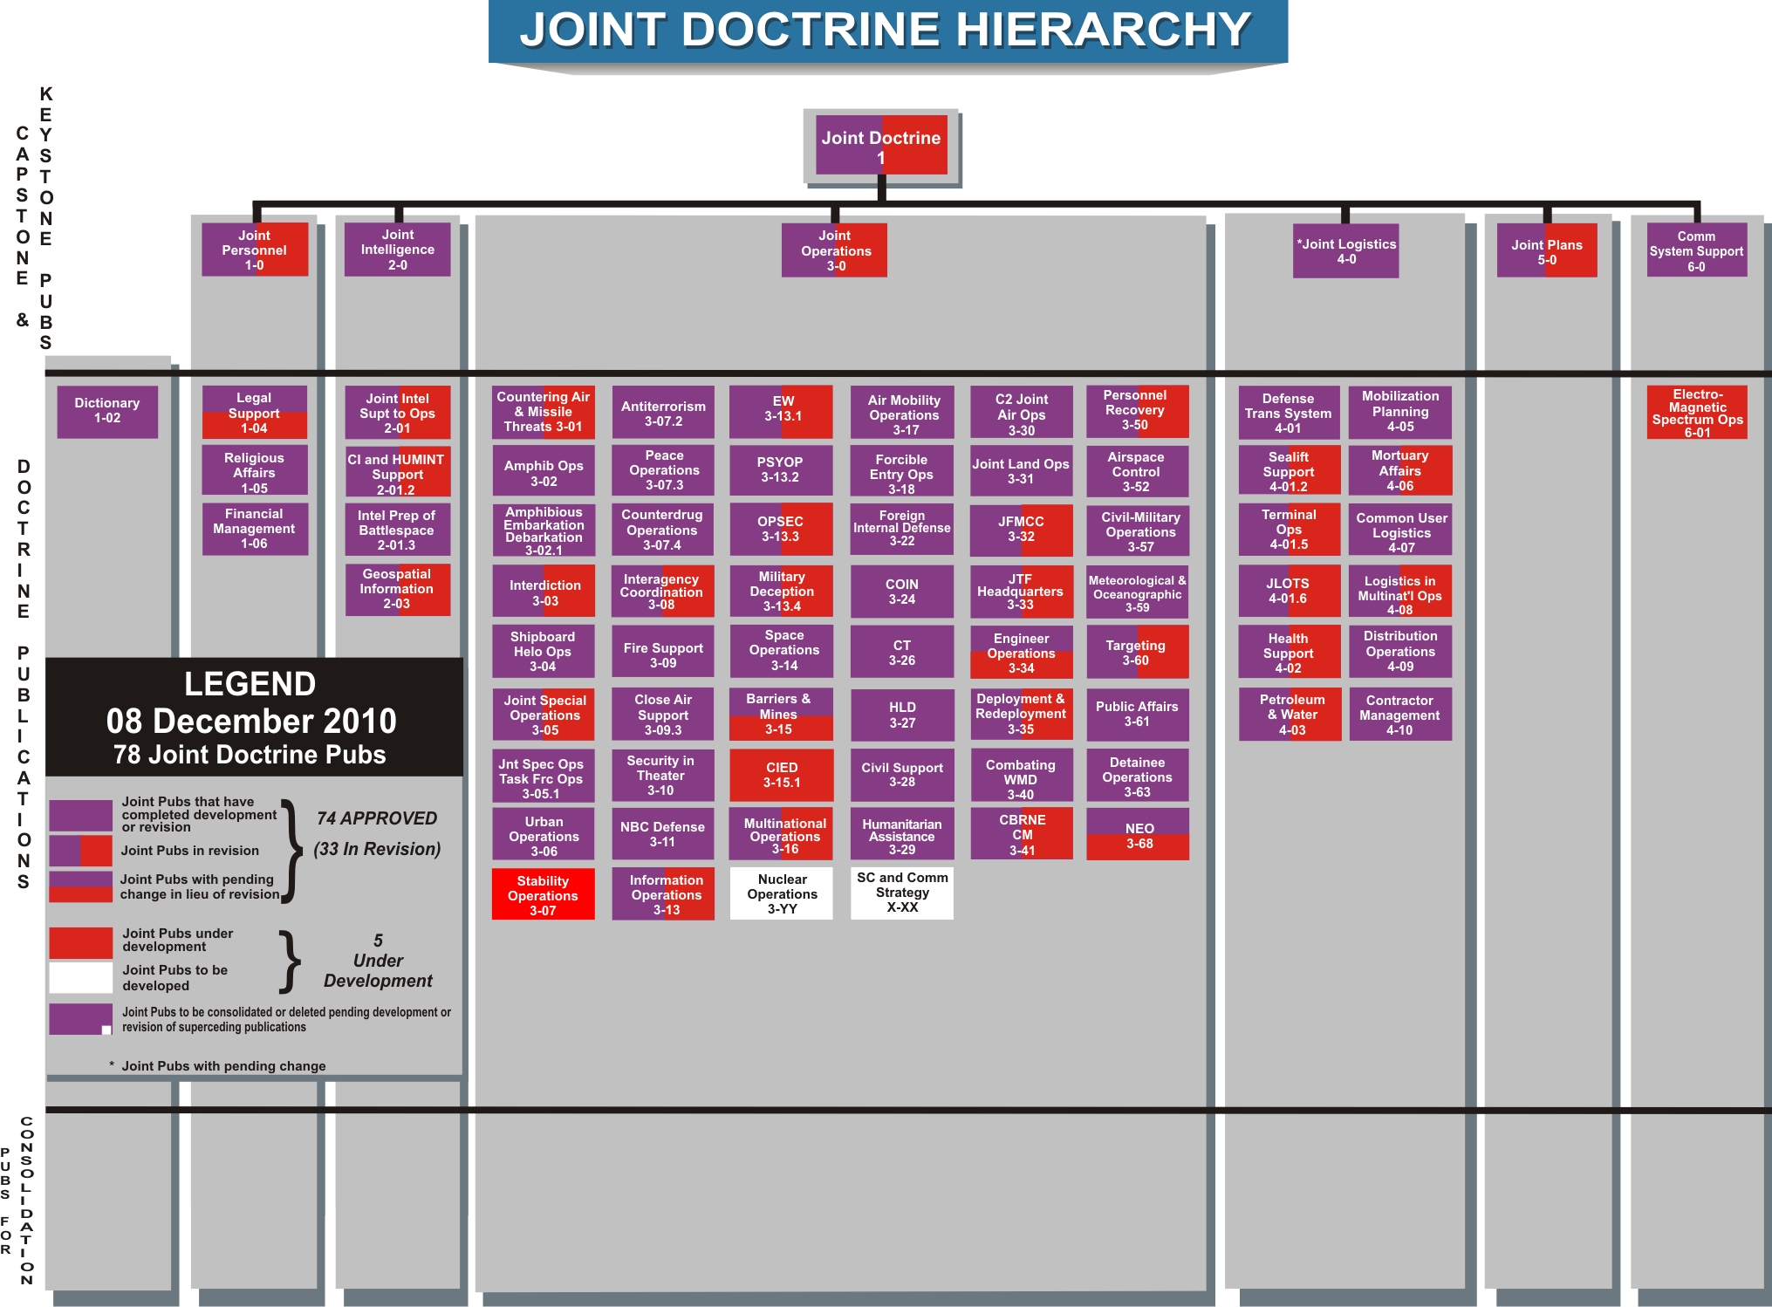
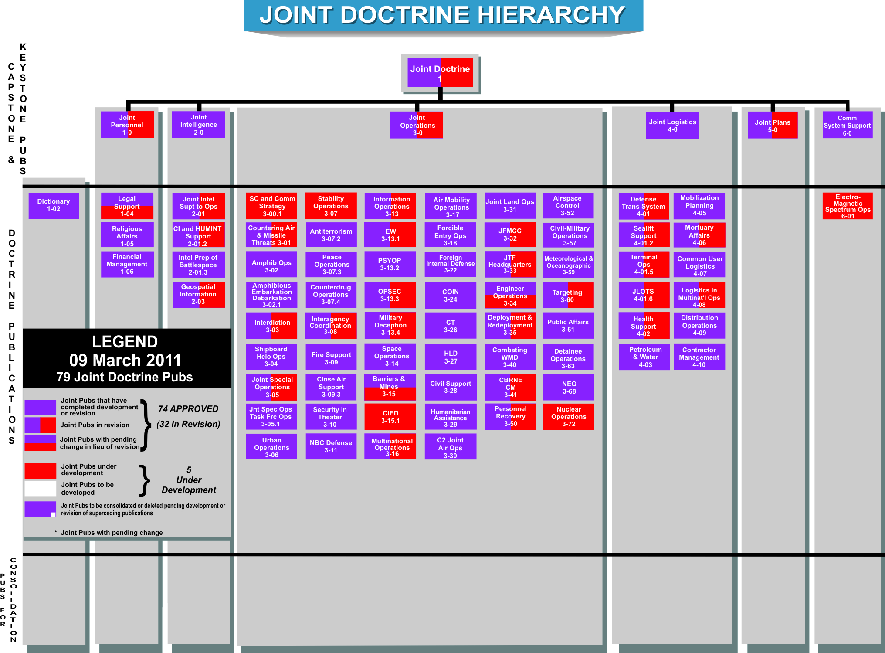
Notes:
47

Slide 48
Levels of coordination
What there is
XML – syntactic interoperability
RDF, OWL, CL – representational interoperability (URIs plus triples) and semantic interoperability (= exposed semantics) -- you use ‘Person’, I use ‘P’, he uses ‘Persn’ …
Creating genuine semantic interoperability, especially with more expressive languages such as OWL or Common Logic is in practice impossible across broad heterogeneous communities

Slide 49
The problem
Interoperability is necessary but not sufficient. It allows automatic processing of content, but only if you can sustain alignments between multiple independent vocabularies simultaneously.
For example, you have class Human Being with subclass Person in one system and P in another. If you want to establish that Person = P, you can do this in such a way that it will be understandable to you and everyone else, and the system will work without any additional help.
However, if you then have to say that Persn = P, and will have to make similar assertions over and over again and to keep the alignments consistent over time, then you will rapidly lose control.

Slide 50
The SE solution: Ontology (only) at the center
Establish common ontology content, which we and our collaborators (and our software control)
Keep this content consistent and non-redundant as it evolves.
Seek semantic sharing only in the SE environment.
so what SE brings is semantic interoperability plus constrained syntax
it brings a kind of substitute for semantic interoperability of source data models, through the use by annotators of ontologies from the single evolving SE suite

Slide 51
SE annotations applied to source data in the DSC Cloud
Dr Malyuta will discuss the DSC Cloud Dataspace in the next segment
See also tomorrow’s presentation:
11:30 Horizontal Integration of Warfighter Intelligence Data

Slide 52
Distributed Common Ground System – Army (DCGS-A)
Semantic Enhancement of the Dataspace
on the Cloud
Dr. Tatiana Malyuta
New York City College of Technology of the City University of New York

Slide 53
Integrated Store of Intelligence Data
Lossless integration without heavy pre-processing
Ability to:
Incorporate multiple integration models / approaches / points of view of data and data-semantics
Perform continuous semantic enrichment of the integrated store
Scalability

Slide 54
Solution Components
Cloud implementation
Cloudbase (Accumulo)
Data Representation and Integration Framework
Comprehensive unified representation of data, data semantics, and metadata
This work was funded by US Army CERDEC Intelligence and Information Warfare Directorate (I2WD).

Slide 55
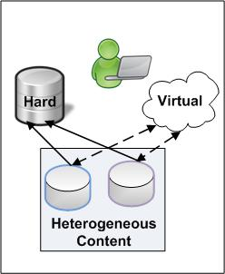
Dealing with Semantic Heterogeneity
Physical Integration. A separate data store homogenizing semantics in a particular data-model – works only for special cases, entails loss and distortion of data and semantics, creates a new data silo.
Virtual integration. A projection onto a homogeneous data-model exposed to users – is more flexible, but may have the problem of data availability (e.g. military, intelligence). Also, a particular homogeneous model has limited usage, does not expose all content, and does not support enrichment

Slide 56
Pursuit of the Holy Grail of Intelligence Data Integration
In a highly dynamic semantic environment evolving in ad hoc ways
how to have it all and have it available immediately and at any time?
Traditional physical and virtual integration approaches fail to respond to these requirements
how to use these data resources efficiently (integrate, query, and analyze)?

Slide 57
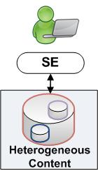
Workable Solution
A physical store incorporating heterogeneous contents.
Data Representation and Integration Framework (DRIF) – is based on a decomposed representation of structured data (RDF-style) and allows collection of data resources without loss and or distortion and thereby achieve representational integration
Light Weight Semantic Enhancement (SE) supports semantic integration and provides a decent utilization capability without adding storage and processing weight to the already storage- and processing-heavy Dataspace

Slide 58
DRIF Dataspace
Integration without heavy pre-processing (ad-hoc rapid integration):
Of any data artifact regardless of the model (or absence of it) and modality
Without loss and or distortion of data and data-semantics
Continuous evolution and enrichment
Pay-as-you-go solution
While data and data-semantics are expected to be enriched and refined, they can be efficiently utilized immediately after entering the DataSpace through querying, navigation, and drilling
D. Salmen et al. Integration of Intelligence Data through Semantic Enhancement. http://stids.c4i.gmu.edu/STIDS2011/papers/STIDS2011_CR_T1_SalmenEtAl.pdf

Slide 59
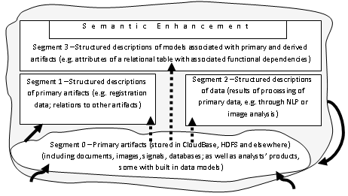
Organization of the DRIF Dataspace
Registration
Ingestion
Extraction [Transformation] / Enrichment

Slide 60
Goals of Semantic Enhancement
Simple yet efficient harmonization strategy
Takes place not by changing the data semantics to which it is applied , but rather by adding an extra semantic layer to it
Long-lasting solution that can be applied consistently and in cumulative fashion to new models entering the Dataspace
Strategy compliant with and complementing the DRIF
Source data models are not changed
Be used efficiently, and in a unified fashion, in search, reasoning, and analytics
Provides views of the Dataspace of different level of detail
Mapping to a particular Über-model or choosing a single comprehensive model for harmonization do not provide the benefits described

Slide 61
Ontology vs. Data Model
Single Ontology
Multiple Data models
Person
Person
Skill
PersonName NetworkSkill ProgrammingSkill
Person Name
Computer Skill
PersonSkill
Last Name First Name Skill
Last Name
First Name
Programming
Skill
Network
Skill
Skill
Person Name Computer Skill
Is-a Bearer-of
Each ontology provides a comprehensive synoptic view of a domain as opposed to the flat and partial representation provided by a data model

Slide 62
Illustration
DRIF Dataspace with lots of data models
Incremental annotations of these data models through SE ontologies
Preserving the native content of data resources
Presenting the native content via the SE annotations
Benefits of the approach

Slide 63
Sources
Source database Db1, with tables Person and Skill, containing person data and data pertaining to skills of different kinds, respectively.
Source database Db2, with the table Person, containing data about IT personnel and their skills:
Source database Db3, with the table ProgrSkill, containing data about programmers’ skills:
PersonID | SkillID
111 | 222
SkillID | Name | Description
222 | Java | Programming
ID | SkillDescr
333 | SQL
EmplID | SkillName
444 | Java

Slide 64
Representation in the Dataspace
Label | Relation | SE Label
Db1.Name | Is-a | SE.Skill
Db2.SkillDescr | Is-a | SE.ComputerSkill
Db3.SkillName | Is-a | SE.ProgrammingSkill
Db1.PersonID | Is-a | SE.PersonID
Db2.ID | Is-a | SE.PersonID
Db3.EmplID | Is-a | SE.PersonID
SE.ComputerSkill | Is-a | SE.Skill
SE.ProgrammingSkill | Is-a | SE.ComputerSkill
Representation of data-models, SE and SE annotations as Concepts and ConceptAssociations
Blue – SE annotations
Red – SE hierarchies
Value and Associated Label | Relation | Value and Associated Label
111, Db1.PersonID | hasSkillID | 222, Db1.SkillID
222, Db1.SkillID | hasName | Java, Db1.Name
222, Db1.SkillID | hasDescription | Programming, Db1.Description
333, Db2.ID | hasSkillDescr | SQL, Db2.SkillDescr
444, Db3.EmplID | hasSkillName | Java, Db3.SkillName
Native representation of structured data

Slide 65
Indexed Contents Based on the SE
Index entries based on the SE and native (blue) vocabularies
Index Entry | Associated Field-Value
111, PersonID | Type: Person
 | Skill: Java
 | Db1.Description:Programming
333, PersonID | Type: Person
 | ComputerSkill: SQL
444, PersonID | Type: Person
 | ProgrammingSkill: Java

Slide 66
Benefits of DRIF + SE
Leverages syntactic integration provided by DRIF, semantic integration provided by the SE vocabulary and annotations of native sources, and rich semantics provided by ontologies in general
Entering Skill = Java (which will be re-written at run time as: Skill = Java OR ComputerSkill = Java OR ProgrammingSkill = Java OR NetworkSkill = Java) will return: persons 111 and 444
Entering ComputerSkill = Java OR ComputerSkill = SQL will return: persons 333 and 444
entering ProgrammingSkill = Java will return: person 444
entering Description = Programming will return: person 111
Allows to query/search and manipulate native representations
Light-weight non-intrusive approach that can be improved and refined without impacting the Dataspace

Slide 67
Index Contents without the SE
Index entries based on native vocabularies
Index Entry | Associated Field-Value
111, PersonID | Type: Person
 | Name: Java
 | Description: Programming
333, ID | Type: Person
 | SkillDescr: SQL
444, EmplID | Type: Person
 | SkillName: Java

Slide 68
Problems
Even for our toy example we can see how much manual effort the analyst needs to apply in performing search without SE – and even then the information he will gain will be meager in comparison with what is made available through the Index with SE.
For example, if an analyst is familiar with the labels used in Db1 and is thus in a position to enter Name = Java, his query will still return only: person 111. Directly salient Db4 information will thus be missed.

Slide 69
Additional Notes on the SE process
Original data and data-semantics are included in the Dataspace without loss and or distortion; thus there is no need to cover all semantics of the Dataspace – what is unlikely to be used in search or is not important for integration will still be available when needed
A complex ontology is not needed – a common and shared vocabulary is sufficient for virtual semantic integration and search/analytics
The approach is very flexible, and investments can be made in specific areas according to need (pay-as-you-go)
The approach is tunable – if the chosen annotations of a particular subset of a source data-model are too general for data analyses, the respective LLOs can be further developed and source models re-annotated

Slide 70
Benefits of the Approach
Does not interfere with the source content
Enhancement enables this content to evolve in a cumulative fashion as it accommodates new kinds of data
Does not depend on the data resources and can be developed independently from them in an incremental and distributed fashion
Provides a more consistent, homogeneous, and well-articulated presentation of the content which originates in multiple internally inconsistent and heterogeneous systems
Makes management and exploitation of the content more cost-effective
The use of the selected ontologies brings integration with other government initiatives and brings the system closer to the federally mandated net-centric data strategy
Creates an integrated content that is effectively searchable and that provides content to which more powerful analytics can be applied

Slide 71
Data Models and SE
Skill
Education
Technical
Education
ComputerSkill
ProgrammingSkill
SQL
Java
C++
PersonID | Name | Description
111 | Java | Programming
222 | SQL | Database

Slide 72
The Meaning of ‘Enhancement’
Amazing semantic enhancement/enrichment of data without any change to data – on a string of the annotation, we put on the top of a database field the whole knowledge system. For example, not only can analysts analyze the data about computer skills “vertically” along the Skill hierarchy, they can analyze it “horizontally” via relations between Skill and Education, and further… While data in the database does not change, its analysis can be richer and richer as our understanding of the reality changes
For this richness to be leveraged by different communities, persons, and applications it needs to be constructed in accordance with the principles of the SE

Slide 73
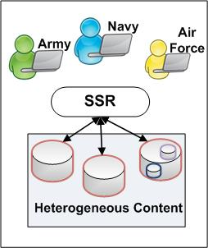
Towards Globalization and Sharing
Using the SE approach to create a Shared Semantic Resource for the Intelligence Community to enable interoperability across systems
Applying it directly to or projecting its contents on a particular integration solution

Slide 74
Building the Shared Semantic Resource
Methodology of distributed incremental development
Training
Governance
Common Architecture of Ontologies to support consistency, non-redundancy, modularity
Upper Level Ontology (BFO)
Mid-Level Ontologies
Low Level Ontologies

Slide 75
Governance
Common governance
coordinating editors, one from each ontology, responsible for managing changes and ensuring use of common best practices
small high-level board to manage interoperability
How much can we embed governance into software?
How much can we embed governance into training?
analogy with military doctrine

Slide 76
Governance principles
All ontologies are expressed in a common shared syntax (initially OWL 2.0; perhaps later supplemented by CLIF) (Syntax for annotations needs to be fixed later; potentially RDF.)
Each ontology possesses a unique identifier space (namespace) and each term has a unique ID ending with an alphanumeric string of the form GO:0000123456
Each ontology has a unique responsible authority (a human being)
If ontologies import segments from other ontologies then imported terms should preserve the original term ID (URI).
Versioning: The ontology uses procedures for identifying distinct successive versions (via URIs).
Each ontology must be created through a process of downward population from existing higher-level ontologies

Slide 77
Governance principles
Each ontology extends from BFO 2.0
Each lower-level ontology is orthogonal to the other ontologies at the same level within the ontology hierarchy
The ontologies include textual (human readable) and logical definitions for all terms.
The ontology uses relations which are unambiguously defined following the pattern of definitions laid down in the Relation Ontology that is incorporated into BFO 2.0
Each ontology is developed collaboratively, so that in areas of overlap between neighboring ontologies authors will settle on a division of terms.

Slide 78
Orthogonality
For each domain, ensure convergence upon a single ontology recommended for use by those who wish to become involved with the Foundry initiative
Thereby: avoid the need for mappings – which are in too expensive, too fragile, too difficult to keep up-to-date as mapped ontologies change
Orthogonality means:
everyone knows where to look to find out how to annotate each kind of data
everyone knows where to look to find content for application ontologies

Slide 79
Orthogonality = non-redundancy for reference ontology modules on any given level
application ontologies can overlap, but then only in those areas where common coverage is supplied by a reference ontology

Slide 80
Definitions (one example of OBO Foundry traffic rules)
all definitions should be of the genus-species form
A =def. a B which Cs
where B is the parent term of A in the ontology hierarchy

Slide 81
Because the ontologies in the Foundry
are built as orthogonal modules which form an incrementally evolving network
scientists are motivated to commit to developing ontologies because they will need in their own work ontologies that fit into this network
users are motivated by the assurance that the ontologies they turn to are maintained by experts

Slide 82
More benefits of orthogonality
helps those new to ontology to find what they need
to find models of good practice
ensures mutual consistency of ontologies (trivially)
and thereby ensures additivity of annotations

Slide 83
More benefits of orthogonality
No need to reinvent the wheel for each new domain
Can profit from storehouse of lessons learned
Can more easily reuse what is made by others
Can more easily reuse training
Can more easily inspect and criticize results of others’ work
Leads to innovations (e.g. Mireot, Ontofox) in strategies for combining ontologies

Slide 84
Basic Formal Ontology
Continuant
Occurrent
biological process
Independent
Continuant
Dependent
Continuant
cell component
molecular function

Slide 85
top level
mid-level
domain level
Basic Formal Ontology (BFO)
Information Artifact Ontology (IAO) | Ontology for Biomedical Investigations (OBI) | Spatial Ontology (BSPO)
Anatomy Ontology (FMA*, CARO) |  | Environment Ontology (EnvO) | Infectious Disease Ontology (IDO*) | Biological Process Ontology (GO*)
Cell Ontology (CL) | Cellular Component Ontology (FMA*, GO*)
 |  |  | Phenotypic Quality Ontology (PaTO)
Subcellular Anatomy Ontology (SAO)
Sequence Ontology (SO*) |  |  | Molecular Function (GO*)
Protein Ontology (PRO*)
Extension Strategy + Modular Organization
Notes:
* = dedicated NIH funding

Slide 86
BFO:continuant
continuant
independent continuant
portion of material
dependent continuant
spatial region
object boundary
site
specifically dependent continuant
generically dependent continuant
realizable entity
quality
disposition
function
role
3D-region
0D-region
1D-region
2D-region
object
object aggregate
fiat object part
information artifact

Slide 87
BFO:occurrent
occurrent
processual entity
process
spatiotemporal region
temporal region
process aggregate
process boundary
processual context
connected spatiotemporal region
scattered spatiotemporal region
spatiotemporal instant
spatiotemporal interval
temporal interval
connected temporal region
scattered temporal region
temporal instant
fiat process part

Slide 88
More than 100 Ontology projects using BFO
http://www.ifomis.org/bfo/users

Slide 89
Basic Formal Ontology
types
Continuant
Occurrent
process, event
Independent
Continuant
thing
Dependent
Continuant
quality
.... ..... .......
instances

Slide 90
Blinding Flash of the Obvious
Continuant
Occurrent
process, event
Independent
Continuant
thing
Dependent
Continuant
quality
quality depends
on bearer
.... ..... .......

Slide 91
Blinding Flash of the Obvious
Continuant
Occurrent
process, event
Independent
Continuant
thing
Dependent
Continuant
quality, …
event depends
on participant
.... ..... .......

Slide 92
Occurrents depend on participants
instances
15 May bombing 5 April insurgency attack
occurrent types
bombing
attack
participant types
explosive device
terrorist group

Slide 93
Blinding Flash of the Obvious
Continuant
Occurrent
process, event
Independent
Continuant
thing
Dependent
Continuant
quality
process is change
in quality
.... ..... .......

Slide 94
What is a datum?
Continuant
Occurrent
process
Independent
Continuant
laptop, book
Dependent
Continuant
quality
datum: a pattern in some medium with a certain kind of provenance
.... ..... .......

Slide 95
General lessons for ontology success
Strategy of low hanging fruit
Lessons learned and disseminated as common guidelines –developers are doing it the same way
Ontologies built by domain experts
Ontologies based on real thinking (not text mining)

Slide 96
Low Hanging Fruit
Start with simple assertions which you know to be universally true
hand part_of body
cell death is_a death
pneumococcal bacterium is_a bacterium
(Computers need to be led by the hand)
Use only the lowest node in the tree of which you are sure that it holds

Slide 97
Examples
How to cope with ontology change (role of versioning, authority structure to ensure evolution in tandem within the networked ontology structure) – how to ensure that resources invested in ontology do not lose their value when the ontology changes
Versioning demands term-IDs which change whenever a term or definition changes

Slide 98
Experience with BFO in building ontologies provides
a community of skilled ontology developers and users
associated logical tools
documentation for different types of users
a methodology for building conformant ontologies by starting with BFO and populating downwards

Slide 99
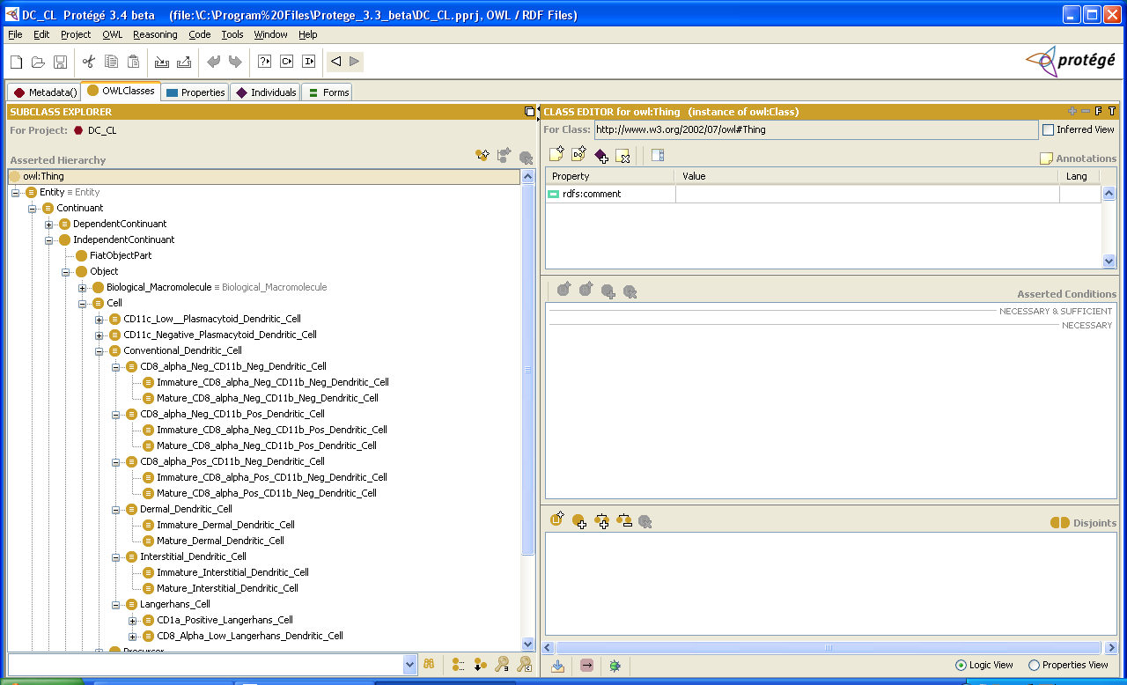
Cell Type Ontology

Slide 100
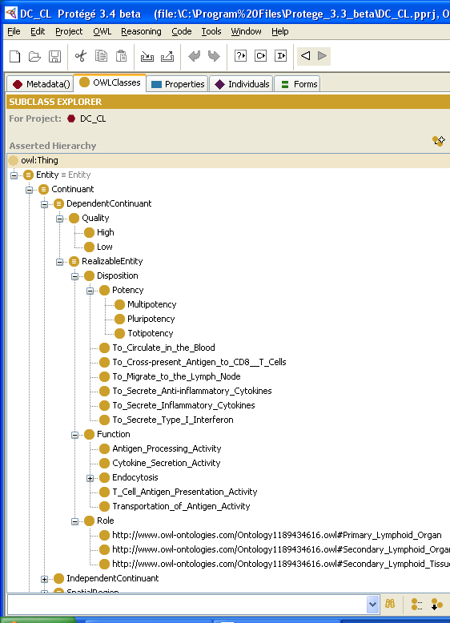
Cell Type Ontology

Slide 101
Conclusion
Ontologists have established best practices
for building ontologies
for linking ontologies
for evaluating ontologies
for applying ontologies
which have been thoroughly tested in use
and which conform precisely to the hub-and-spokes strategy of the UCore and C2 efforts

Slide 102

A Strategy for Military Ontology
Dr. Bill Mandrick
Senior Ontologist
Data Tactics

Slide 103
Agenda
Introductory Remarks
Previous Information Revolution
Ontology & Military Symbology
Asserted Ontologies
Inferencing
Realizing the strategy

Slide 104
Introductory Remarks

Slide 105
Ontology Defined
Ontology is the science of representing, defining, and relating the kinds and structures of objects, properties, events, processes and relations in every area of reality.
An ontology is an exhaustive classification of entities in some sphere of being, which results in the formulation of robust and shareable descriptions of a given domain.
(e.g. Physics, Biology, Medicine, Intelligence, etc.).

Slide 106
Ontology Defined
“...partial semantic account of the intended conceptualization of a logical theory...”

Slide 107
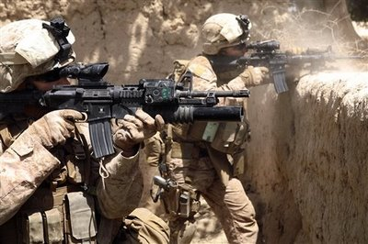

Orders of Reality
1st Order. Reality as it is. In the action in the upper image to the right, reality is what is, not what we think is happening, as we peer through the fog of war.
2d Order. Participant Perceptions. What we believe is happening as we peer through the fog of war. Examples: as a participant in the action shown in the upper image or as a member of an operations center in the lower image.
3rd Order. Reality as we record it. In the lower image, the computer displays are 3rd order reality.
The gaps between the orders of reality introduce risk. These gaps are not the only form of risk but reducing these gaps contributes to reducing risk.
107

Slide 108
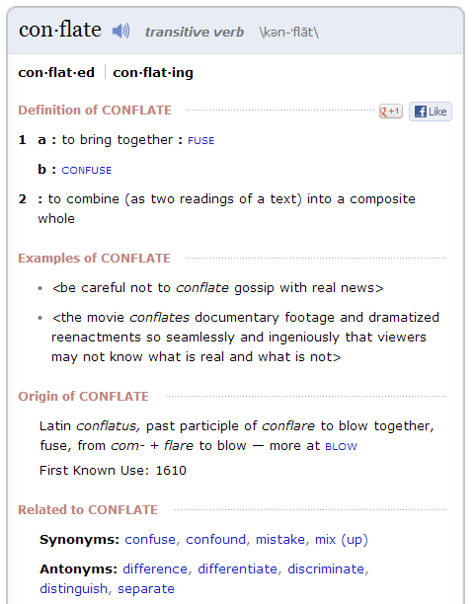
Conflation

Slide 109
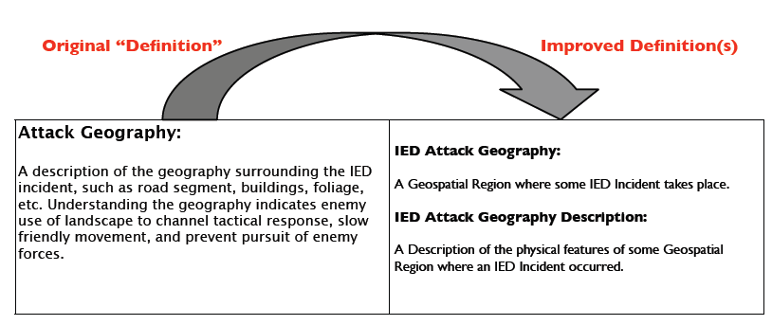
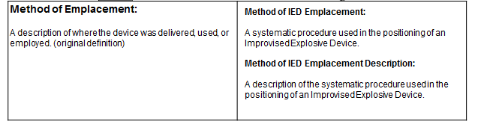
2 Examples of Conflation

Slide 110
Warfighters’ Information Sharing Environment
Intelligence
Fire Support
Targeting
Maneuver &
Blue Force Tracking
Air Operations
Civil-Military Operations
Logistics

Slide 111
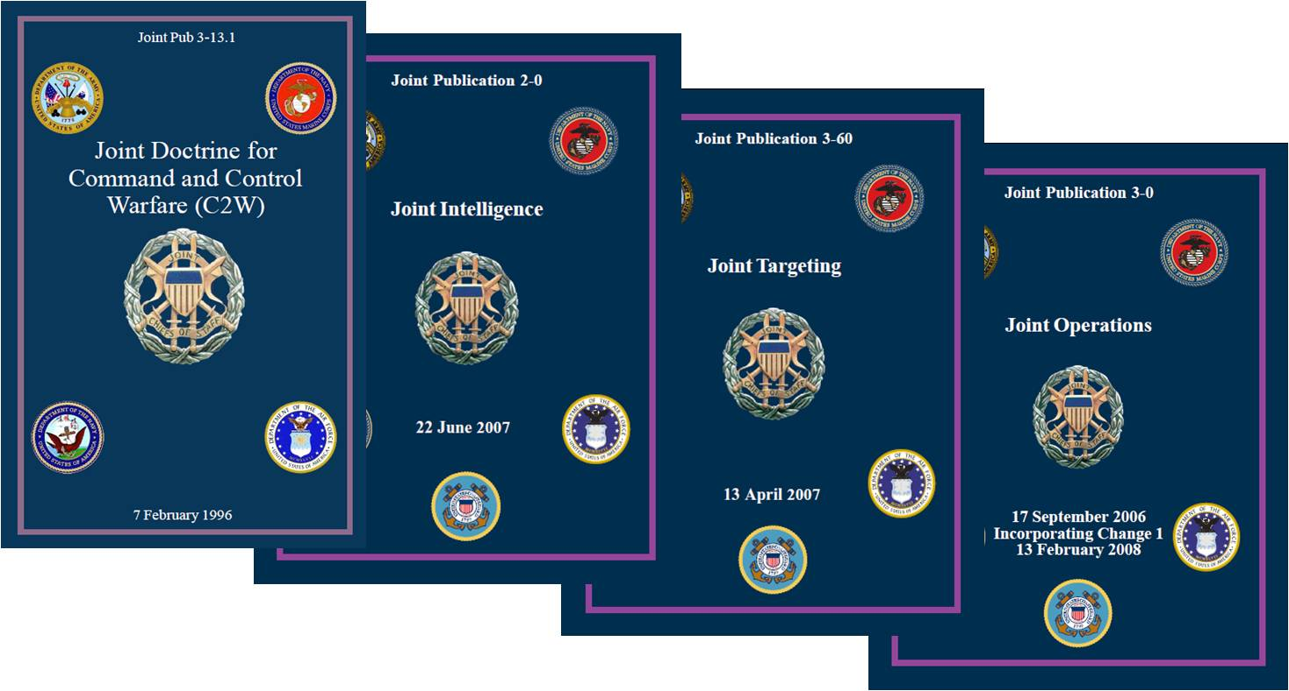
Authoritative References
Merriam-Webster’s Collegiate Dictionary | Joint Publication 1-02 DoD Dictionary of Military and Related Terms | Joint Publication 3-0 Joint Operations
Joint Publication 3-13 Joint Command and Control | Joint Publication 3-24 Counterinsurgency | Joint Publication 3-57 Civil-Military Operations
JP 3-10, Joint Security Operations in Theater | Joint Publication 3-16 Multinational Operations | Joint Publication 5-0 Joint Operations Planning
Warfighter Lexicon
Controlled Vocabulary
Stable
Horizontally Integrated
Common Operational Picture
http://www.dtic.mil/doctrine/

Slide 112
Ontology(ies) that enables interoperability among members of an Operations Center and other warfighters.
Notes:
112

Slide 113
Doctrinal Publications
Consistent Terminology (Data Elements, Names and Definitions)
JP 1-02
DoD Dictionary
JP 2-0
Intelligence
JP 3-0
Operations
JP 3-16
Multinational
Operations
JP 3-33
JTF
Headquarters
JP 4-0
Logistics
JP 6-0
Comm
Support
Area of Interest
X
X
X
Area of Operations
X
X
X
X
Area of Responsibility
X
X
X
X
C2 Systems
X
X
X
Civil-Military Operations
X
X
Key: word for word
Notes:
This image represents the consistent use of terms across the Joint Publications. The information in this slide was collected by reviewing the glossaries of eight Joint Publications in four areas: intelligence, operations, logistics, and command and C2 systems. The five terms in the left side column (i.e., area of interest, area of operations, area of responsibility, command and control [C2] systems, and civil-military operations) are all listed in the Joint Publication (JP) 1-02, DoD Dictionary of Military and Associated Terms. The “Xs” show that they are used selectively throughout the Joint Publications. If the authors saw no need for the concept represented by the term, the term was not used.
If, however, the authors of different publications need to use a concept for which JP 1-02 has a term, it is expected that the authors will use the term already in JP 1-02, and in fact they do. This drawing of terms from a common source facilitates alignment between Joint Publications and, more importantly, is understood by warfighters to be the foundation of interoperability in joint operations.
Interestingly, the glossary of previous version of JP 6-0, Joint Communications System, references terms that were used in earlier editions of JP 6-0 but are not used in that edition. For example, the term “command, control, communications, and computer systems” has been replaced by the term “command and control systems” (C2 systems) because (1) the C2 systems term was in general use before “command, control, communications, and computer systems” and (2) both terms represent the same concept.

Slide 114
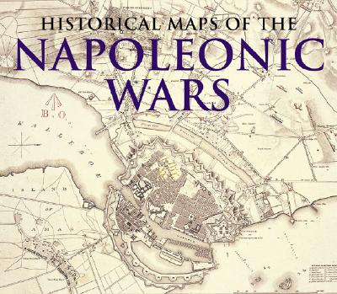
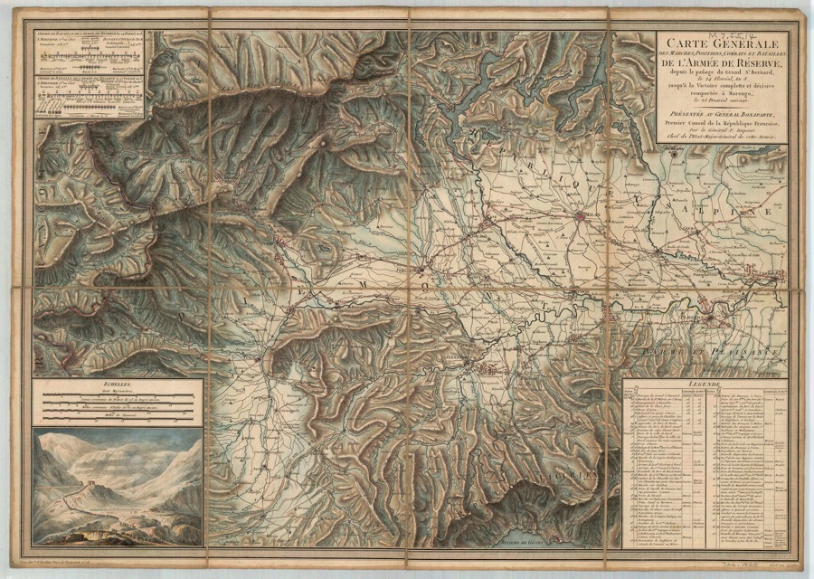
Previous Information Revolution

Slide 115
Previous Information Revolution
1800 Cartographic Revolution
Explosion of production, dissemination and use of cartography
Revolutionary and Napoleonic wars
Several individual armies in the extended terrain
New spatial order of warfare
Urgent need for new methods of spatial management…*
*Source: Paper Empires: Military Cartography and the Management of Space

Slide 116
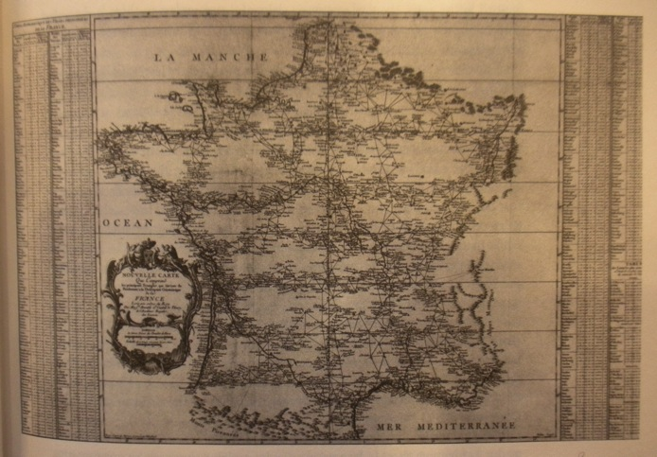
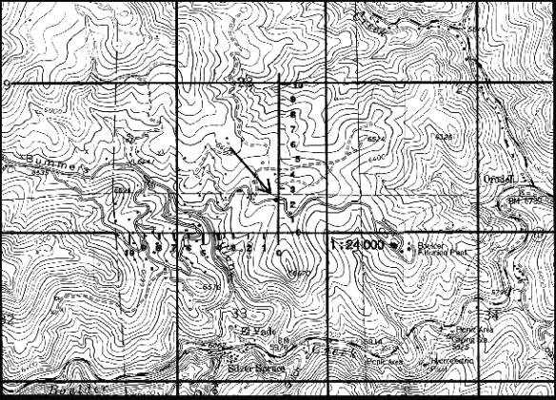
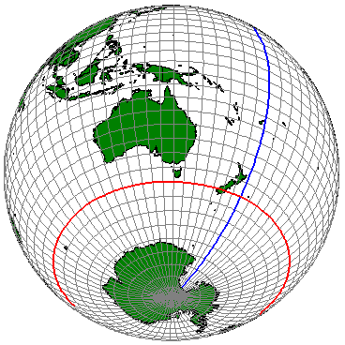
Standardizing Geospatial Information
Triangulation
Military Grid Reference System
Latitude Longitude

Slide 117
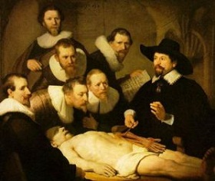
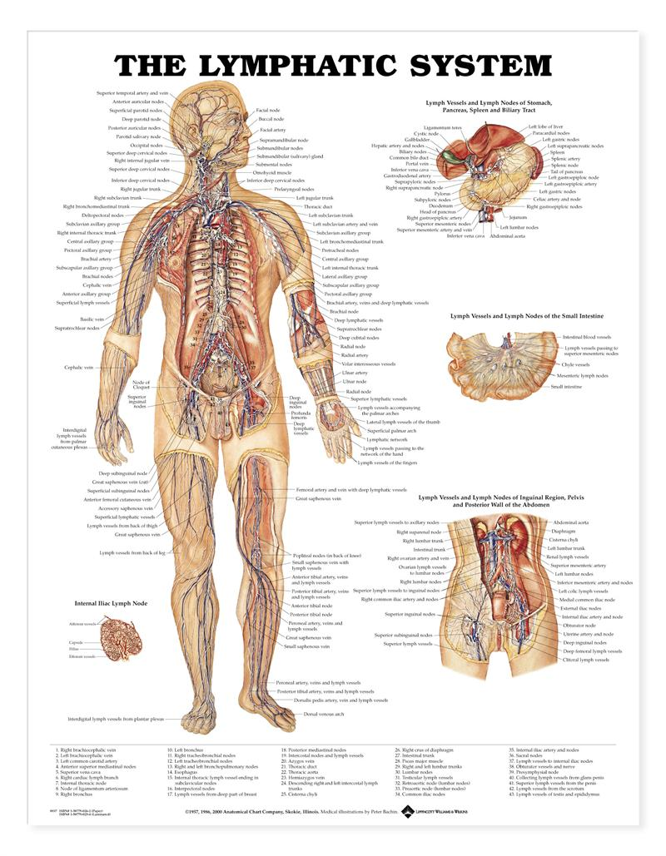
Interoperable Semantics (example: Anatomy & Physiology)
Standardized Labels
Anatomical Continuants
Physiological Occurrents
Teachable
Inferencing
Horizontally Integrated
Sharing of Observations
Accumulated Knowledge

Slide 118
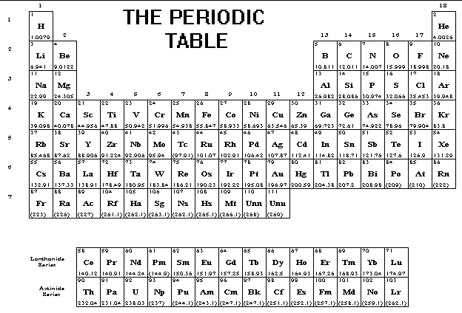




Standardized Symbols
Ground
Resistor
Capacitor

Slide 119
Ontology & Military Symbology
Elements of Military Ontology
Represent Entities and Events found in military domains
Used to develop the Common Operational Picture
Used to develop Situational Awareness
Used to develop Situational Understanding
Used for Operational Design
Used to Task Organize Forces
Used to Design/Create Information Networks
Enhance the Military Decision Making Process

Slide 120
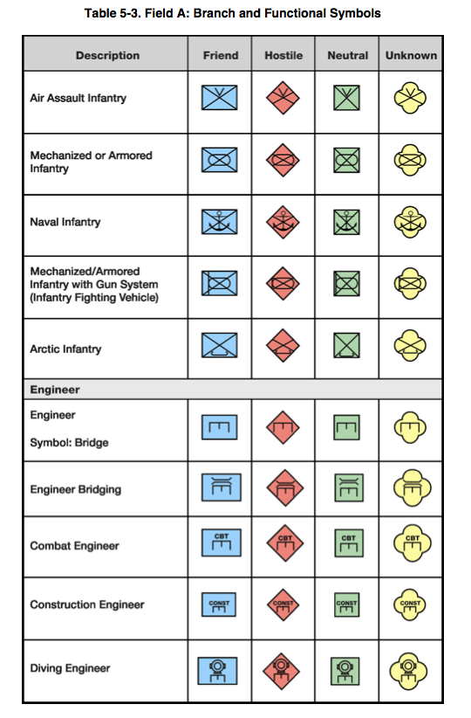
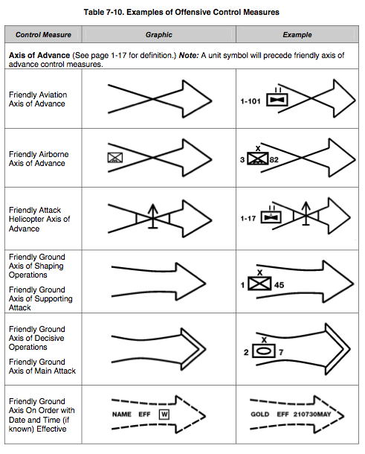
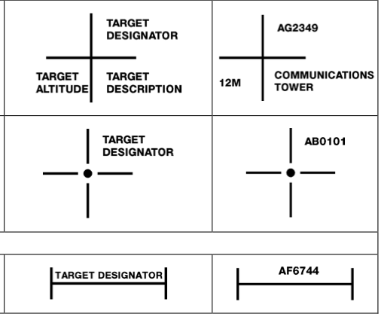
Military Symbology
Sample of Military Standard 2525 Military Symbology

Slide 121
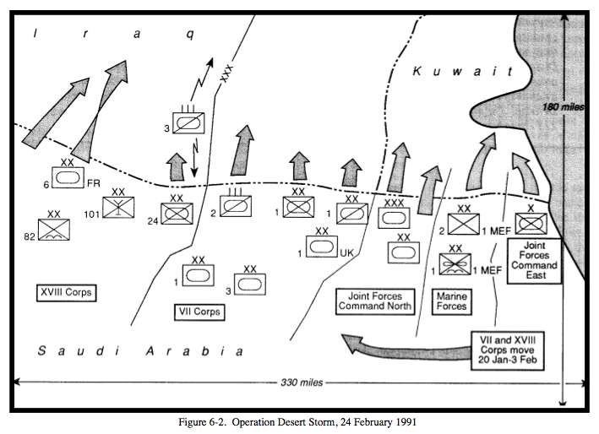
Map Overlays

Slide 122
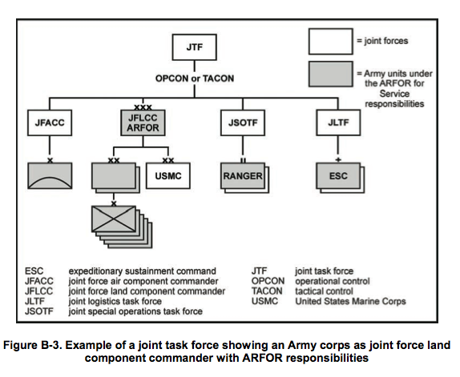
Task Organizing
Task-Organizing — The act of designing an operating force, support staff, or logistic package of specific size and composition to meet a unique task or mission. Characteristics to examine when task-organizing the force include, but are not limited to: training, experience, equipage, sustainability, operating environment, enemy threat, and mobility. (JP 3-05)
Ontological methods are used in the process of Task-Organizing
A Task-Organization is the Output (Product) of Task Organizing
A Task-Organization is a Plan or part of a Plan
A Plan is an Information Content Entity

Slide 123
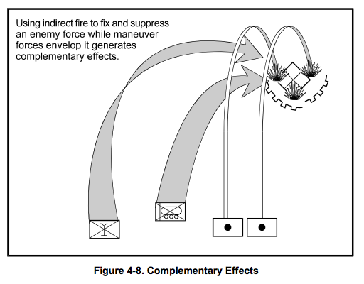
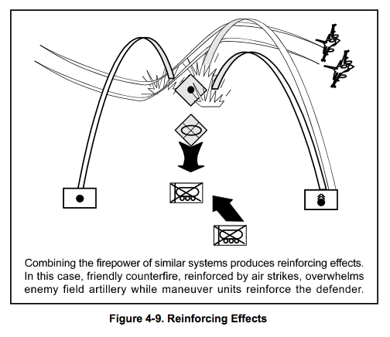
Operational Design
Operational Design — The conception and construction of the framework that underpins a campaign or major operation plan and its subsequent execution. See also campaign; major operation. (JP 3-0)
Military Ontologies help planners and operators “see” and understand the relations between Entities and Events in the area of operations.
Military Ontologies are prerequisites of military innovations such as Airborne Operations, Combined Fires and Joint Operations.
Military Ontologies are prerequisites for the creation of effective information systems.
Source: FM 3-0 Operations

Slide 124
Asserted (Reference) Ontologies
Generic Content
Aggressive Reuse
Multiple Different Types of Context
Better Definitions
Prerequisite for Inferencing
Intelligence Product
Target List
Target Intelligence Product
Geospatial Intelligence Product
Target Nomination List
High-Payoff Target List
Human Intelligence Product
Signals Intelligence Product
Candidate Target List
Protected Target List

Slide 125
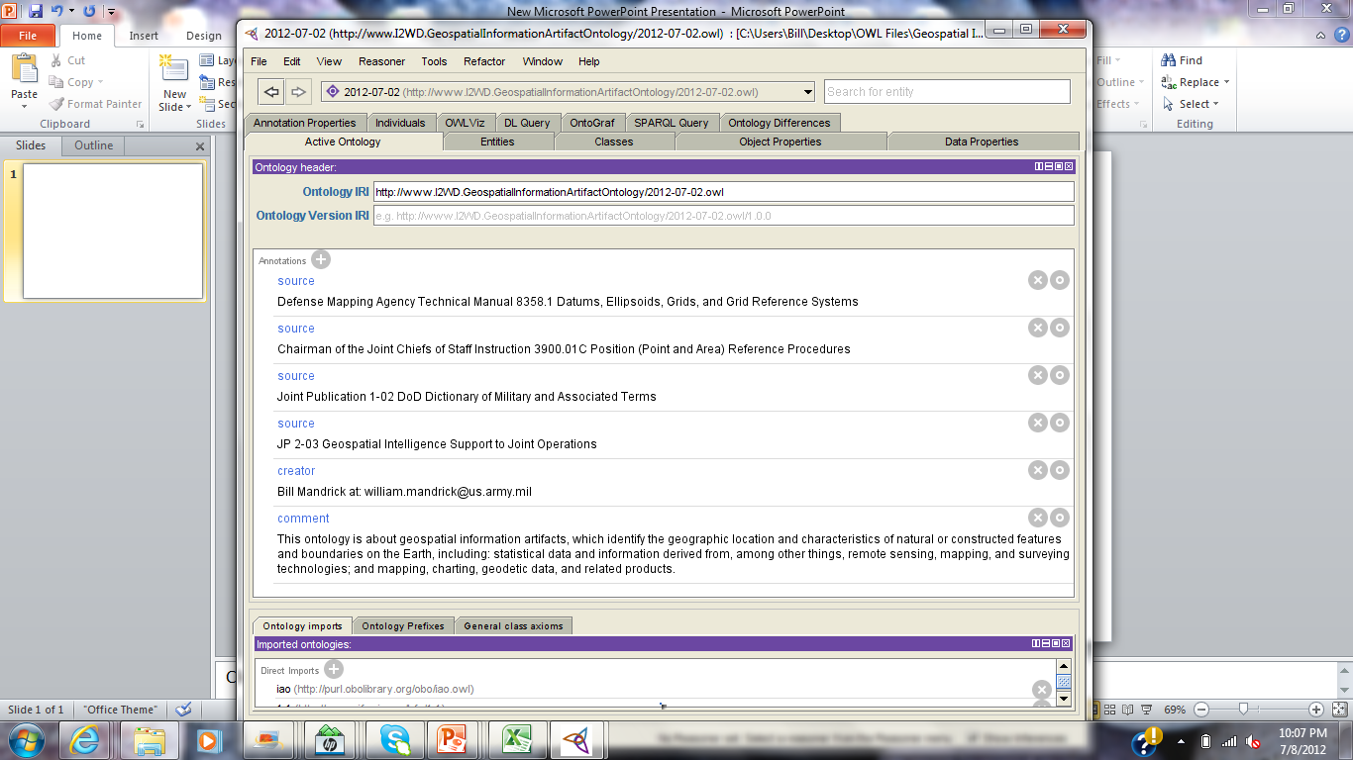

Slide 126
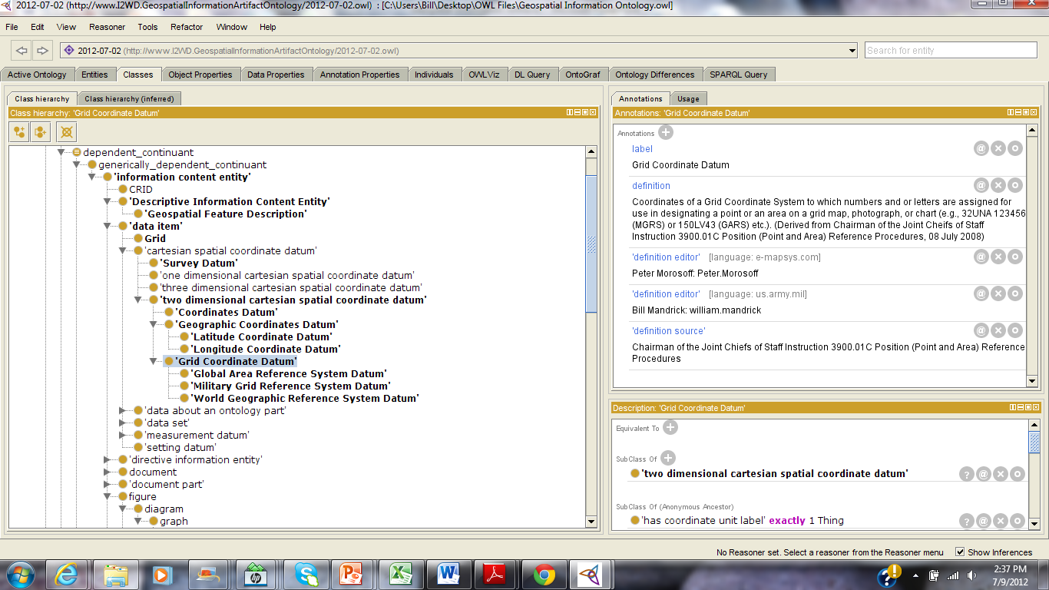
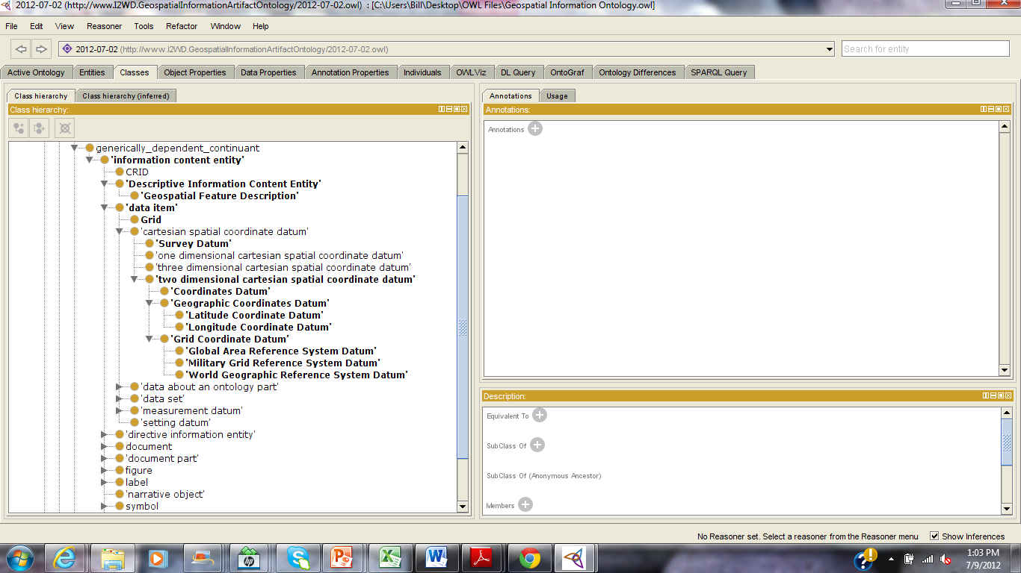
Grids & Coordinates

Slide 127
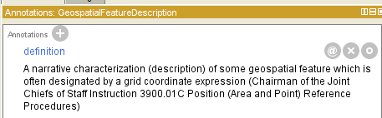
Geospatial Feature Descriptions

Slide 128
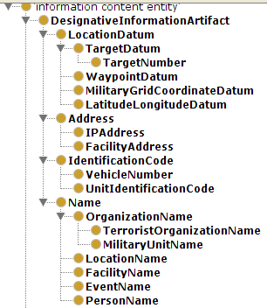
Designative Information Artifacts

Slide 129
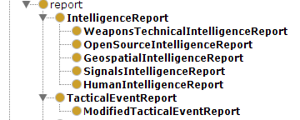
Descriptive Information Artifacts

Slide 130
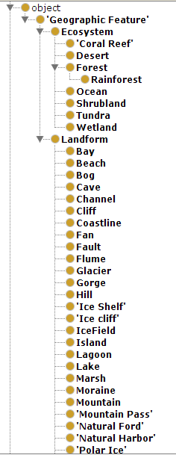


Geographic Features & Geospatial Regions

Slide 131


Geospatial Regions
*Combine
Geographic/Geospatial content from other ontology (see next slide)

Slide 132




Artifacts

Slide 133






Facilities

Slide 134




Facility by Role

Slide 135




Vehicles

Slide 136




Weapons

Slide 137





Human Ontologies

Slide 138


Organizations

Slide 139


Processes

Slide 140
Inferencing

Slide 141
Relations
How we make sense of the world
Message In Plain English (MIPE)
How Data becomes Information
Infantry Company is part_of a Battalion (Continuant to Continuant)
Civil Affairs Team participates_in a Civil Reconnaissance (Continuant to Occurrent)
Military Engagement is part_of a Battle Event (Occurrent to Occurrent)
House is a Building (Universal to Universal)
3rd Platoon, Alpha Company participates_in Combat Operations (Instance to Universal)
3rd Platoon, Alpha Company is located_at Forward Operating Base Warhorse (Instance to Instance)

Slide 142


Standardized Relations

Slide 143

2 Data Model Labels
Region.water.distanceBetweenLatrinesAndWaterSource
Region.water.fecalOrOralTransmittedDiseases
How are these labels used?
No way to standardize or horizontally integrate
Trying to pack too much into each label
Contain elements from several asserted ontologies
Need to be Decomposed into elements
Relating elements from different asserted ontologies
Common events and objects in an Area of Operations

Slide 144
Asserted Ontologies
Geospatial Region
Region.water.distanceBetweenLatrinesAndWaterSource
Village
Tribal Region
Area Of Operations
Water Source
Act
Latrine
Pond
Act Of Measurement
Act Of Observation
Well
Cesspool
Act Of Analysis
Geographic Coordinates
Measurement Result
Latitude Longitude Coordinates
Military Grid Reference System Coordinates
Distance Measurement Result
Height Measurement Result
Universal Transverse Mercator Coordinates
Depth Measurement Result

Slide 145



Region.water.fecalOrOralTransmittedDiseases
Cholera Epidemic
cause_of
Cholera
cause_of
Collection of Bacterium
Report Date Time Group
Well
Bacterial
Pathogen Role
Village Assessment
instance_of
instance_of
instance_of
instance_of
instance_of
150029OCT2010
Particular Bacterial Pathogen Role
has role
stamps
describes
located in

Slide 146
Relating Asserted Ontologies
Water Source
Region.water.fecalOrOralTransmittedDiseases
Latrine
Pond
Role
Well
Cesspool
has_location
Pathogen Role
Medicinal Role
has_role
Consumable Role
Microorganism
part_of
cause_of
Bacterium
Virus
Protozoan
Event
Disease
Contamination Event
Epidemic Event
Cholera
Shigellosis
Disease Transmission Event
Hepatitis A

Slide 147



Unpacking: Region.water.distanceBetweenLatrinesAndWaterSource
Geographic
Coordinates Set
designates
Geopolitical
Entity
instance_of
Spatial Region
has location
Village Name
is_a
has location
Distance Measurement Result
designates
Well
Village
Latrine
instance_of
instance_of
instance_of
instance_of
instance_of
’16 meters’
‘VT 334 569’
measurement_of
‘Khanabad Village’
located near
located in

Slide 148
Sample Ontology Terms/Labels
Contamination Event | Consumable Role | Disease Event | Epidemic Event
Geographic Coordinates Set | Geospatial Region | Measurement Result | Microorganism
Pathogen Role | Tribal Region | Village | Water Source
Application Neutral Labels (Preferred Labels)
Much better for Horizontal Integration
database query
Inferencing
Standardization
Reuse (e.g. Disease Ontology already exists)
Training

Slide 149

Conclusions
Situational Understanding
Shared Lexicon
Horizontal Integration of Preferred Labels
Need Training & Governance

Slide 150
Realizing the Strategy: A Practical Introduction to Ontology Building
Barry Smith
&
Bill Mandrick

Slide 151
Agenda
Standardized Processes
Scoping the Domain
Creating Initial Lexicon
Initial Ontology
Feedback and Iteration
Publish and Share

Slide 152
Standardized Process
Method:
A particular procedure for accomplishing or approaching something, esp. a systematic or established one.
2. Orderliness of thought or behavior; systematic planning or action: “combination of knowledge and method”.
Merriam-Webster’s Collegiate Dictionary

Slide 153

Sample of Repeatable Processes
The Repeatable Targeting Process

Slide 154


Repeatable Processes are developed though repeated observation, abstraction, and documentation

Slide 155

The Repeatable Process for the...
Military Decision Making Process (MDMP)...
as depicted in Doctrine
This is a highly refined and documented process
All Leaders, Planners, and Decision-Makers are well versed in the MDMP

Slide 156


Slide 157


Guide to a Repeatable Process for Ontology Creation (v 0.1)

Slide 158

Horizontal Integration of Intelligence

Slide 159

A Joint Publication for H.I. needs to be developed
Joint Publication 6-02
Horizontal Integration of
Information
Under Development
2012

Slide 160
Scoping the Domain

Slide 161

Scope the Domain
1.1 Subject Matter Expert (SME) Interaction
1.2 Identify Authoritative References
1.3 Survey Authoritative References
1.4 Define the Domain
1.5 Describe the Domain
1.6 Devise Metrics

Slide 162
Authoritative References
Merriam-Webster’s Collegiate Dictionary | Joint Publication 1-02 DoD Dictionary of Military and Related Terms | Joint Publication 3-0 Joint Operations
Joint Publication 3-13 Joint Command and Control | Joint Publication 3-24 Counterinsurgency | Joint Publication 3-57 Civil-Military Operations
JP 3-10, Joint Security Operations in Theater | Joint Publication 3-16 Multinational Operations | Joint Publication 5-0 Joint Operations Planning
http://www.dtic.mil/doctrine/

Slide 163


Slide 164
Metrics: 20 Questions for C2 Related Domains
What is the baseline definition/description for this domain?
What are the primary activities involved in this domain?
What are the subordinate activities in this domain?
Who participates in these activities?
What environment do these activities take place in?
What are the intended outcomes of these activities?
What are the intended products of these activities?
What information is consumed in these activities?
Who consumes this information?
What information is produced by these activities?
Where is this information found?
Where is this information stored?
What organizations are involved in this domain?
How are these organizations related?
What do these outputs contribute to?
What is the relation between agents and organizations in this domain?
What are the ultimate goals for the domain?
What are the subordinate goals for the domain?
What larger enterprise/objective does this domain contribute to?
What happens if these activities fail to produce their intended outcomes?

Slide 165

Create Initial Lexicon

Slide 166
Building the Domain Lexicon
Joint Operation Planning Process: Planning activities associated with joint military operations by combatant commanders and their subordinate joint force commanders in response to contingencies and crises. Joint operation planning includes planning for the mobilization, deployment, employment, sustainment, redeployment, and demobilization of joint forces. (Joint Publication 3-0 Joint Operations)
Planning Activity | Joint Military Operation | Combatant Commander
Subordinate Joint Force Commander | Contingency Event | Crisis Event
Mobilization Event | Deployment Event | Employment Event
Sustainment Event | Redeployment Event | Demobilization
Joint Force | Planning Process | Response

Slide 167
Definitions
Always make Two-Part Definitions which include:
Reference to Parent Class (Genus) &
Differentia (Species)
Example:
Dog: An Animal [parent class]…
which is a member of the genus Canis, probably descended from the common wolf, that has been domesticated by man since prehistoric times; occurs in many breeds [differentia from all other animals]
(Merriam Webster’s Collegiate Dictionary)

Slide 168
Definitions
Original “Definition”
Improved Definition(s)
Attack Geography: A description of the geography surrounding the IED incident, such as road segment, buildings, foliage, etc. Understanding the geography indicates enemy use of landscape to channel tactical response, slow friendly movement, and prevent pursuit of enemy forces. | IED Attack Geography: A Geospatial Region where some IED Incident takes place. IED Attack Geography Description: A Description of the physical features of some Geospatial Region where an IED Incident takes place.

Slide 169


Example 2: Method of Emplacement
Original “Definition”
Improved Definition(s)
Method of Emplacement: A description of where the device was delivered, used, or employed. (original definition)
Method of IED Emplacement:
A systematic procedure used in the positioning of an Improvised Explosive Device.
Method of IED Emplacement Description:
A description of the systematic procedure used in the positioning of an Improvised Explosive Device.

Slide 170
Example 3: Method of Employment
Original “Definition”
Improved Definition(s)
Method of Employment: A description of where the device was delivered, used, or employed. (original definition)
Method of IED Employment:
A systematic procedure used in the delivery of an Improvised Explosive Device.
Method of IED Employment Description:
A description of the systematic procedure used in the delivery of an Improvised Explosive Device.

Slide 171
Doctrinal Definitions
intelligence estimate — The appraisal, expressed in writing or orally, of available intelligence relating to a specific situation or condition with a view to determining the courses of action open to the enemy or adversary and the order of probability of their adoption. (JP 2-0)

Slide 172


Slide 173




Create Initial Ontology

Slide 174
Independent Continuant
Object Aggregate/Object/Site
Specifically
Dependent
Continuant
Generically Dependent Continuant
Independent Continuant
Object Aggregate/Object/Site
Process
Agent
Quality
Physical Characteristic
- Eye Color
- Height
- Weight
Information Artifact
- Directive
-- Plan
-- Prescription
-- Guidance
- Description
-- Narrative
-- Comment
-- Remark
- Designation
--Address
-- Grid Coordinate
-- Name
--Code
- Measurement
-- Altitude
-- Height
-- Weight
-- Distance
Natural Process
- Biological Process
- Weather Process
- Geological Process
Organization
- Military Organization
- Political Organization
Organism
- Human Being
- Non-Human Animal
- Bacteria
Act
- Political Act
- Violent Act
- Planning Act
Role
- Geospatial Role
-- Area of Interest
-- Area of Operations
- Personal Role
--Key Leader Role
--Insurgent Role
- Artifact Role
--IED Component
- Target Role
- Equipment Role
- Cargo Role
Physical Artifact
- Vehicle
- -Tractor
- Weapon
- - Rifle
- - Improvised Explosive Device
System
-Weapon System
- C2 System
--Targeting System
- Intelligence System
Capability
- Sustained Rate of Fire
- Lethal Capability
- Skill
Site
- Geospatial Region

Slide 175

Military Ontology is the task of establishing and representing the salient types of entities and relations in a given domain (Battlespace)
Ontology Review
Revisions Process with SME’s
SME Feedback

Slide 176


Publish and Share

Slide 177



Intelligence Ontology Suite
Home | Introduction | PMESII-PT | ASCOPE | References | Links
Welcome to the I2WD Ontology Suite!
I2WD Ontology Suite: A web server aimed to facilitate ontology visualization, query, and development for the Intelligence Community. I2WD Ontology Suite provides a user-friendly web interface for displaying the details and hierarchy of a specific ontology term.
No. | Ontology Prefix | Ontology Full Name | List of Terms
1 | AO | Agent Ontology
2 | ARTO | Artifact Ontology
3 | BFO | Basic Formal Ontology
4 | EVO | Event Ontology
5 | GEO | Geospatial Feature Ontology
6 | IIAO | Intelligence Information Artifact Ontology
7 | LOCO | Location Reference Ontology
8 | TARGO | Target Ontology

Slide 178

I2WD Ontology Suite

Slide 179
Practical Introduction to Ontology Building: Some Samples
Barry Smith

Slide 180
A simple battlefield ontology (from W. Ceusters)
Spatial region
located-in
object
Ontology
weapon
vehicle
building
person
corpse
transforms-into
submachine
gun
mortar
tank
car
POW
soldier

Slide 181

Ontology used for annotating a situation
Spatial region
located-in
object
weapon
vehicle
building
person
corpse
Ontology
transforms-into
submachine
gun
mortar
tank
car
POW
soldier
Situation

Slide 182
Referent Tracking (RT) used for representing a situation
Ontology
#5
#6
#7
#8
Situational
model
uses
uses
uses
uses
#1
#2
uses
#3
#4
#10
Situation

Slide 183
Referent Tracking preserves identity
Ontology
use the same weapon
#6
#7
#8
Situational
model
use the same type of weapon
uses
uses
uses
#2
uses
#3
#4
#10
Situation

Slide 184
Specific relations versus generic relations
Ontology
#5
#6
#7
#8
faithful
Situational
model
uses
uses
uses
uses
#1
#2
uses
#3
#4
#10
Situation

Slide 185
Specific relations versus generic relations
Ontology
uses
NOT faithful
Situational
model
Situation

Slide 186
Representation of times when relations hold
soldier
Ontology
private
sergeant
sergeant-major
at t₁
at t₂
at t₃
Situational
model
#3
Situation

Slide 187
Ontology
#5
#6
uses
at t₁
Situational
model
uses
at t₁
#1
#2
Situation

Slide 188
Ontology
uses
at t₂
#5
after the death of #1
Situational
model
at t₂
#1
#2
Situation

Slide 189
RT deals with conflicting representations by keeping track of sources
Ontology
corpse
asserts at t₂
#5
#6
uses
at t₂
Situational
model
uses
at t₁
uses
at t₁
at t₃
#1
#2
Situation

Slide 190
RT deals with conflicting representations by keeping track of sources
Ontology
corpse
asserts at t₄
#5
#6
uses
at t₂
Situational
model
uses
at t₁
uses
at t₁
at t₃
#1
#2
Situation

Slide 191
Advantages of Referent Tracking
Preserves identity
Allows to assert relationships amongst entities that are not generically true
Appropriate representation of the time when relationships hold
Deals with conflicting representations by keeping track of sources
Mimics the structure of reality

Slide 192
Towards a Video Ontology
Video as information artifact
Process by which video is created
Video content for tagging (man shooting rifle)

Slide 193
How a video ontology can help the process of intelligence analysis
The video file
The content of (what is represented by) the video file
The process of inserting text into the video that could later be queried
The video's role in the intelligence/decision making process
VideoFile has_role IntelligenceProduct

Slide 194
Example
An FMV PO focuses the CSP on some suspicious activity. The PO zooms in, and identifies three tracked vehicles moving through a NAI.
He immediately tags a 15-second clip with the text
"3 x tracked vehicles pending ID"
That clip is also automatically tagged with MGRS and DTG. After reporting this EEI to the supported BCT, an imagery analyst immediately conducts a search for "tracked vehicles" within the time window reported.
The motion imagery clip in question pops up, and the analyst adds/modifies the text to
"3 x likely Ukrainian T-72 moving from north to south through NAI 9 at low speed; tank commanders had hatch open and did not appear to anticipate contact."

Slide 195
Terms
VideoFile
ActOfTagging
ActOfQuerying
TextString
GridCoordinatesDatum (MGRS)
DateTimeGroup
EssentialElementOfInformationRole (EEI)
ImageryAnalysis
ActOfSearching
ActOfTextModification
TemporalInterval (TimeWindow)
TankCommanderRole
UkranianTank72
ManeuverEvent
EnemyContactEvent
BrigadeComabtTeam (BCT)
TrackedVehicle
VehicleCount
NamedAreaOfInterest (NAI)

Slide 196
Terms
VideoFile
ActOfTagging
ActOfQuerying
TextString
GridCoordinatesDatum (MGRS)
DateTimeGroup
EssentialElementOfInformationRole (EEI)
ImageryAnalysis
ActOfSearching
ActOfTextModification
TemporalInterval (TimeWindow)

Slide 197


Slide 198
Terms
VideoFile
ActOfTagging
ActOfQuerying
TextString
GridCoordinatesDatum (MGRS)
DateTimeGroup
EssentialElementOfInformationRole (EEI)
ImageryAnalysis
ActOfSearching
ActOfTextModification
TemporalInterval (TimeWindow)

